Slide 1
Exam II Review
CSCI 1951a

Slide 2
Lecture 7.5 pagerank

Slide 3
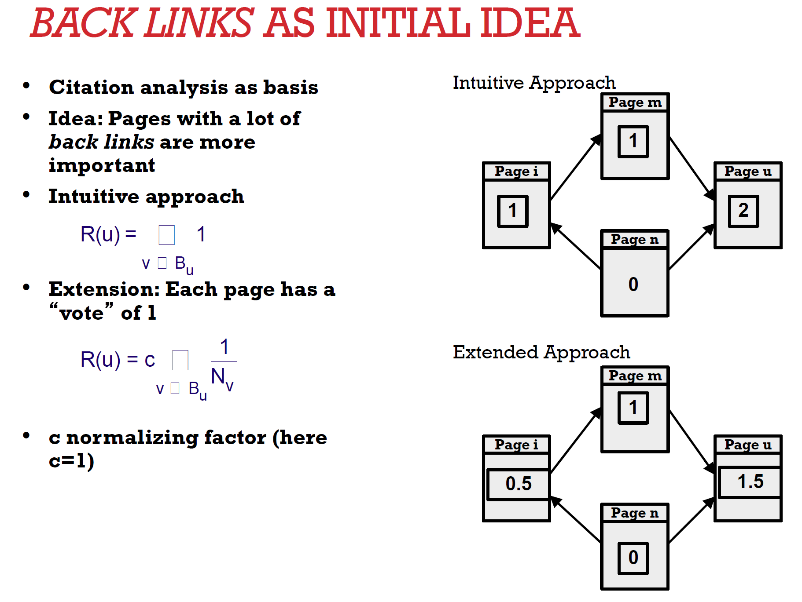

Slide 4
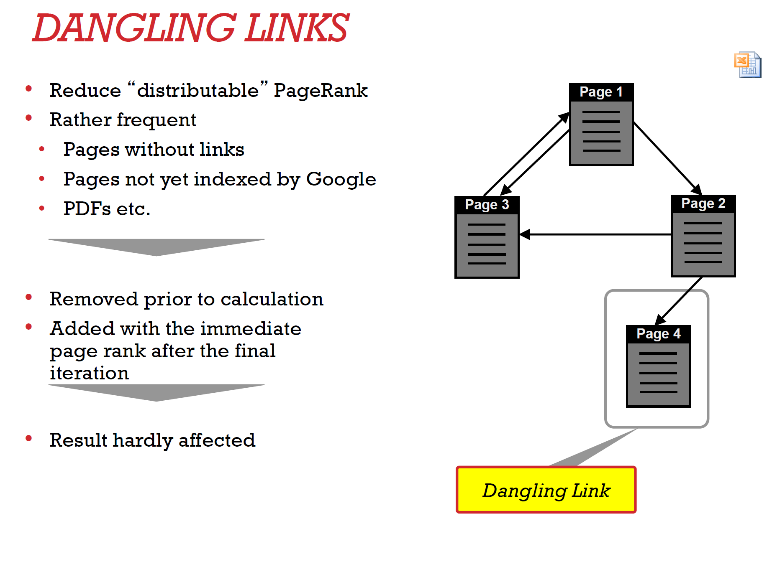

Slide 5
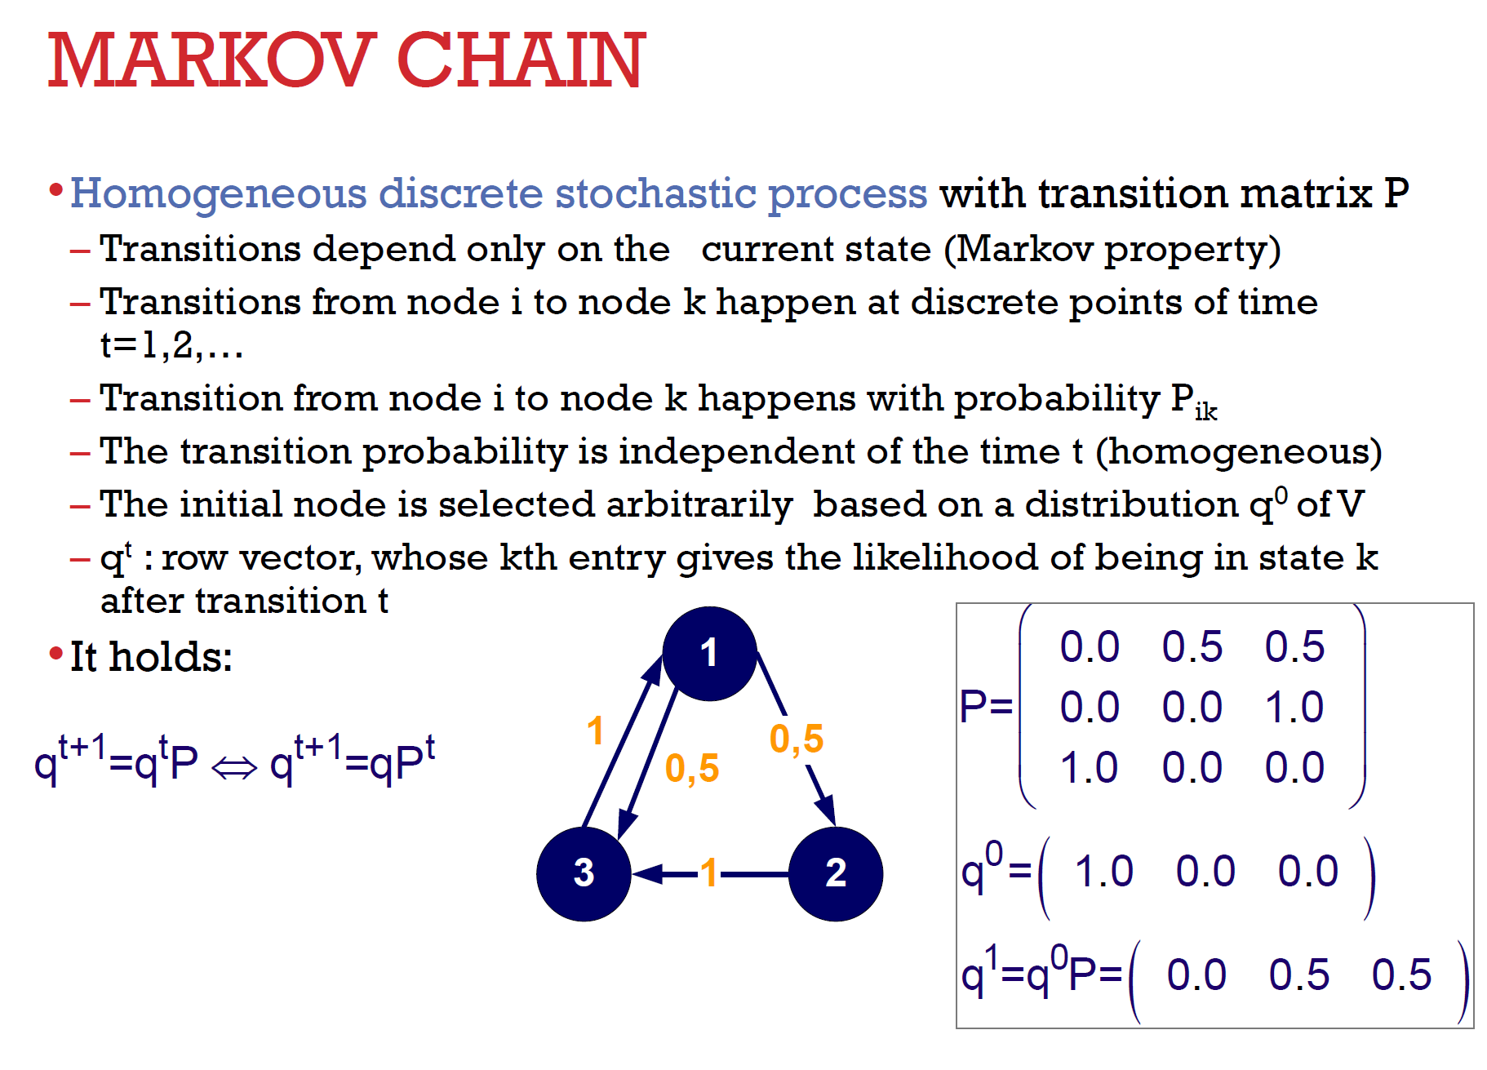

Slide 6
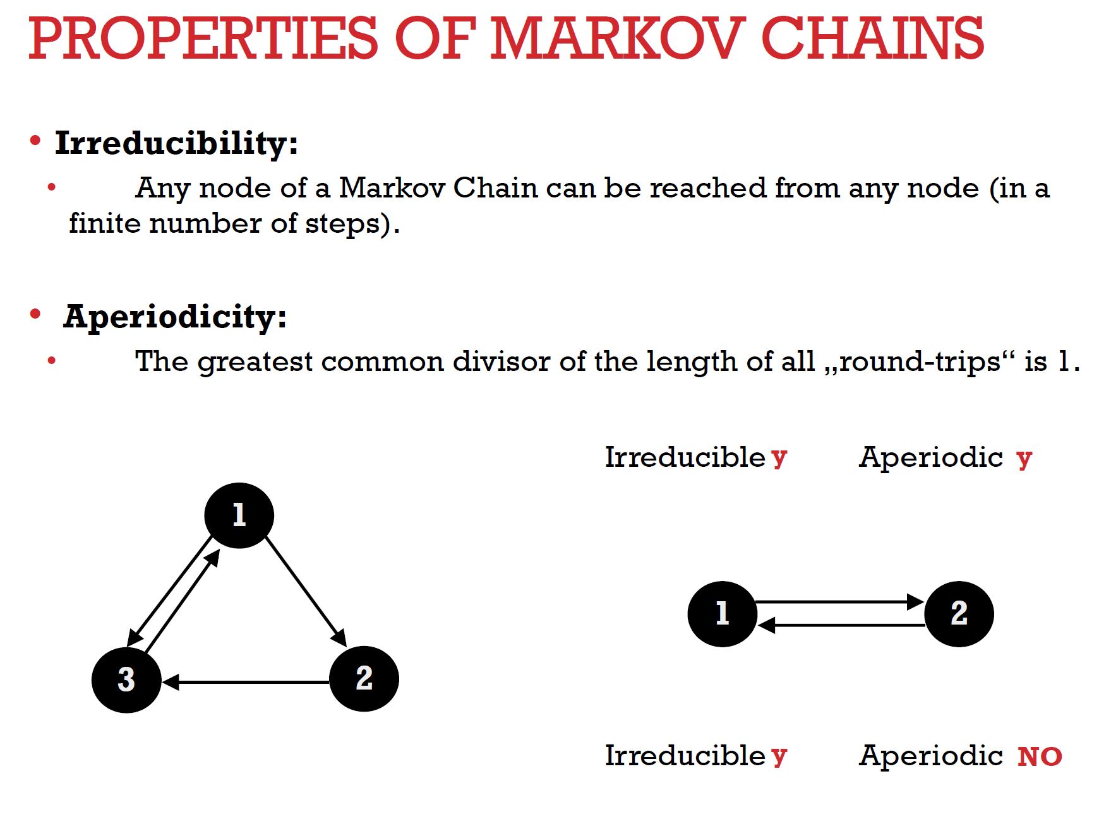

Slide 7
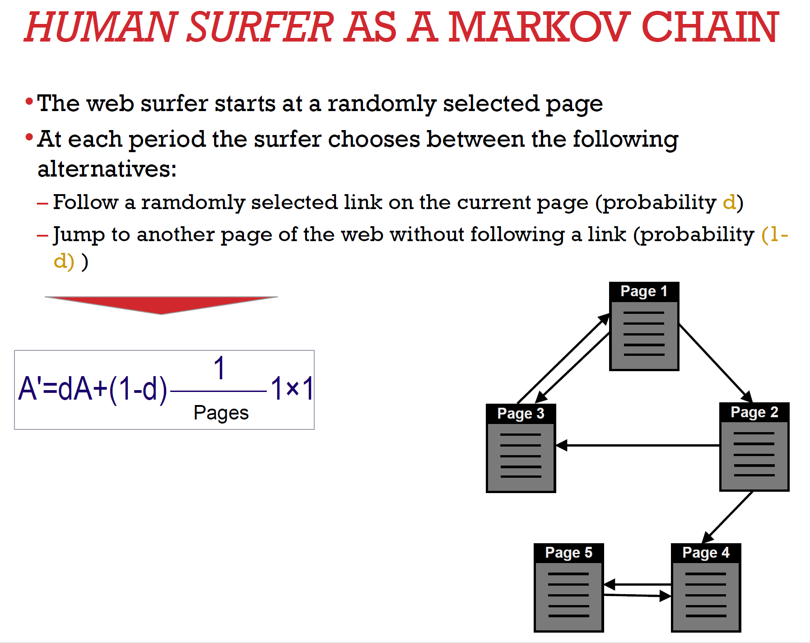

Slide 8
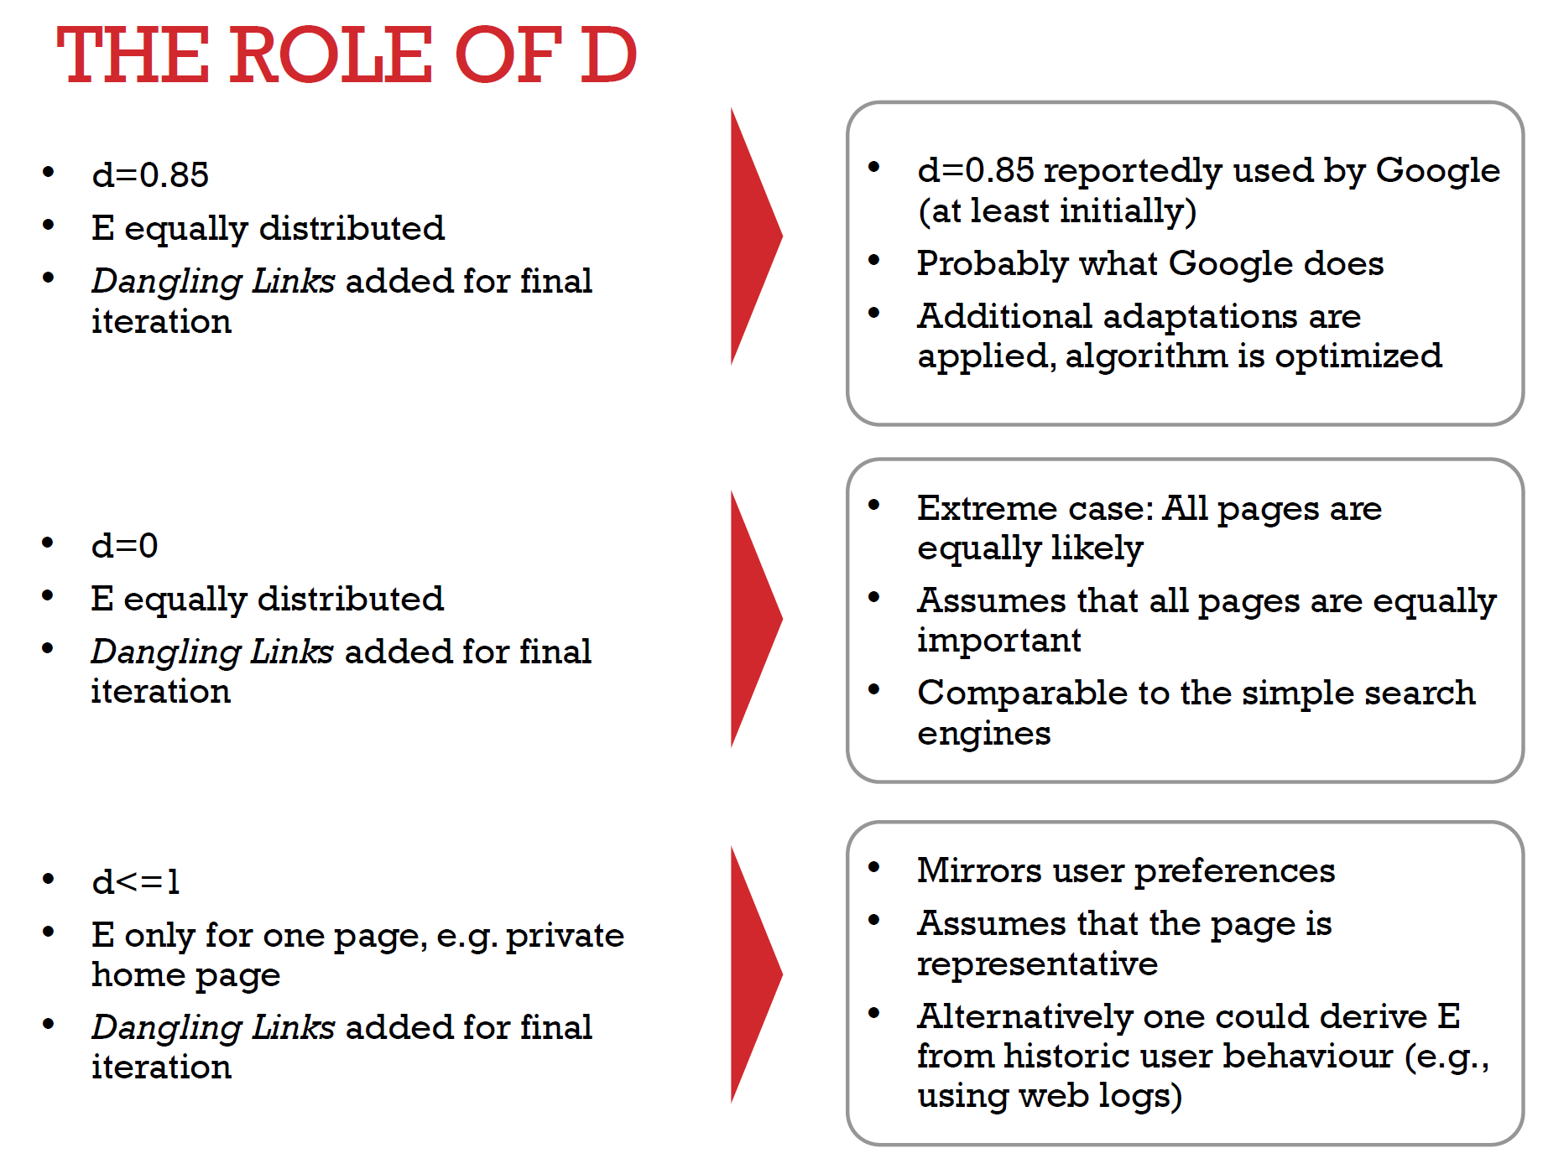

Slide 9
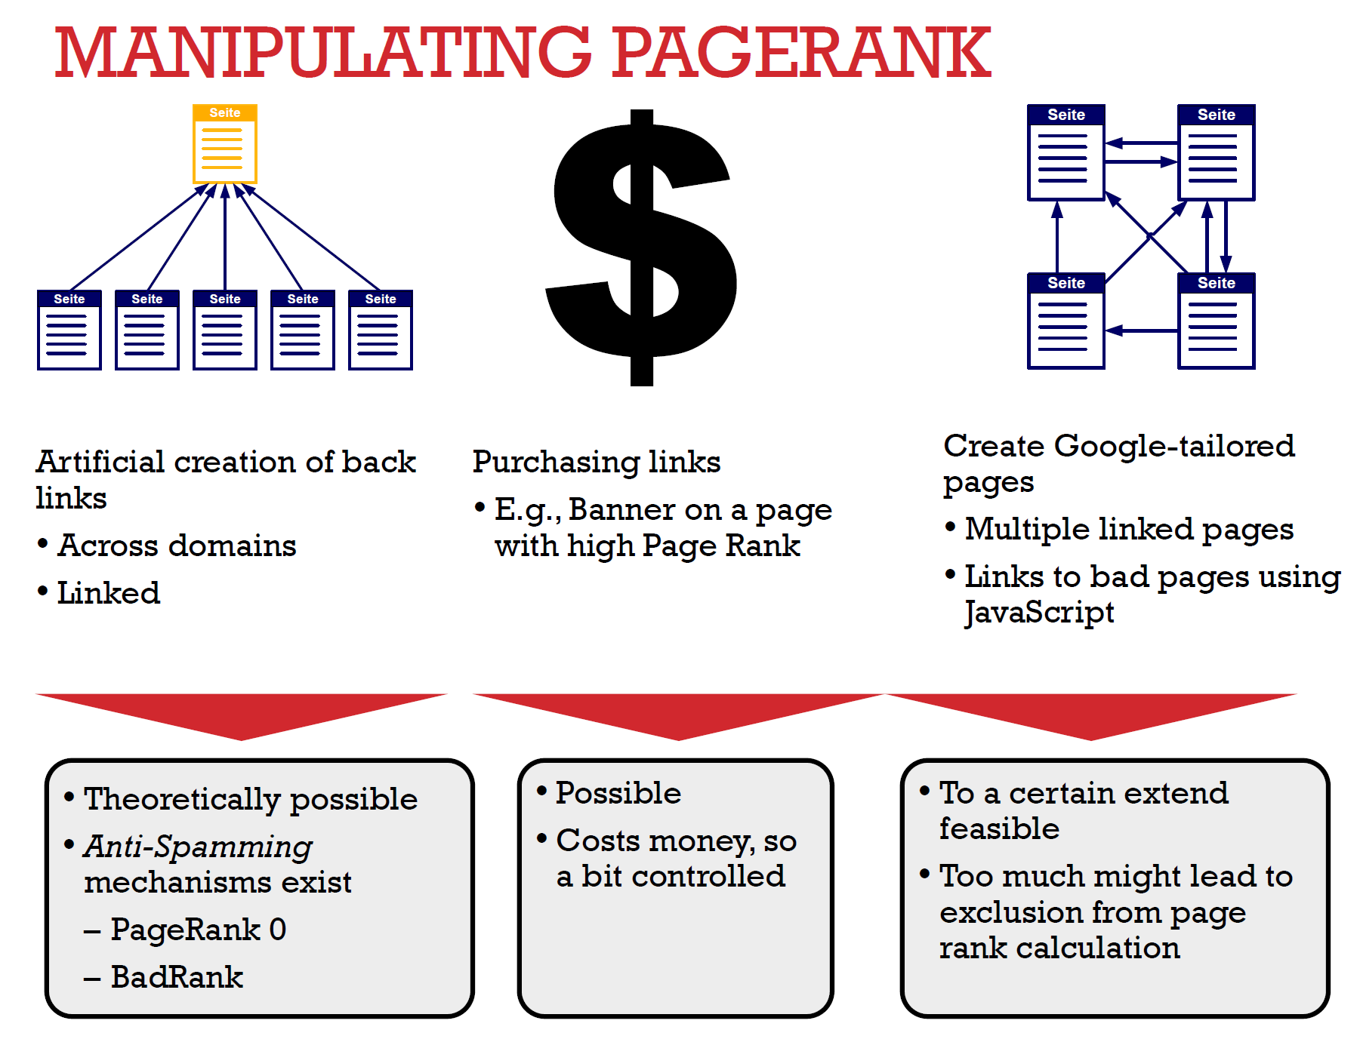

Slide 10
Lecture 9.0 ML intro

Slide 11
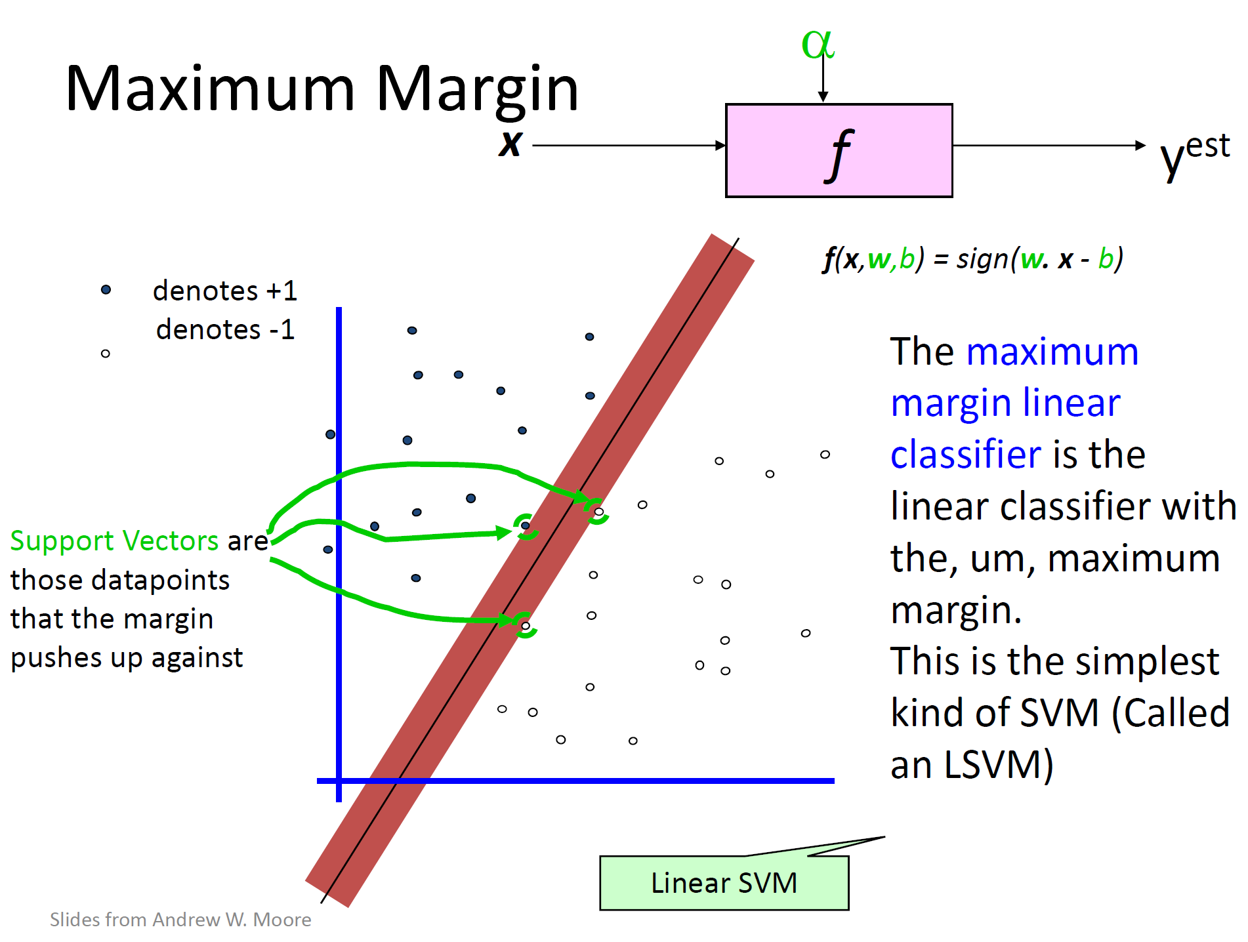

Slide 12

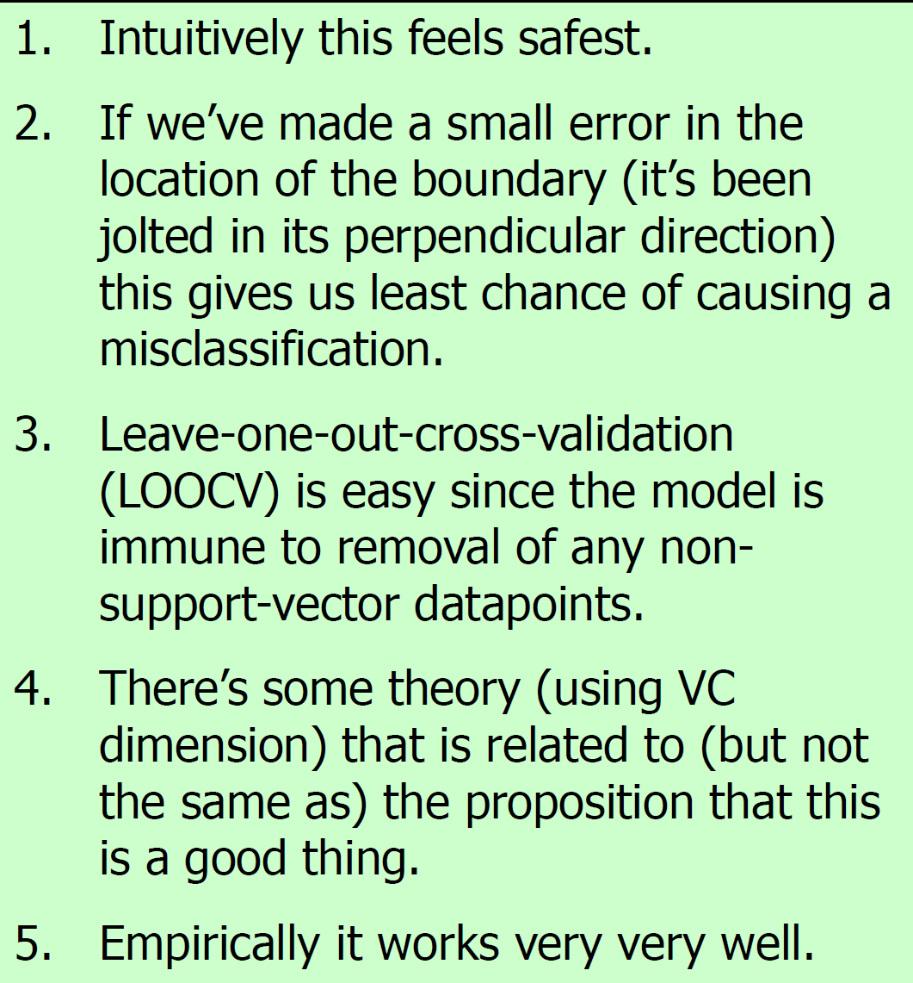

Slide 13
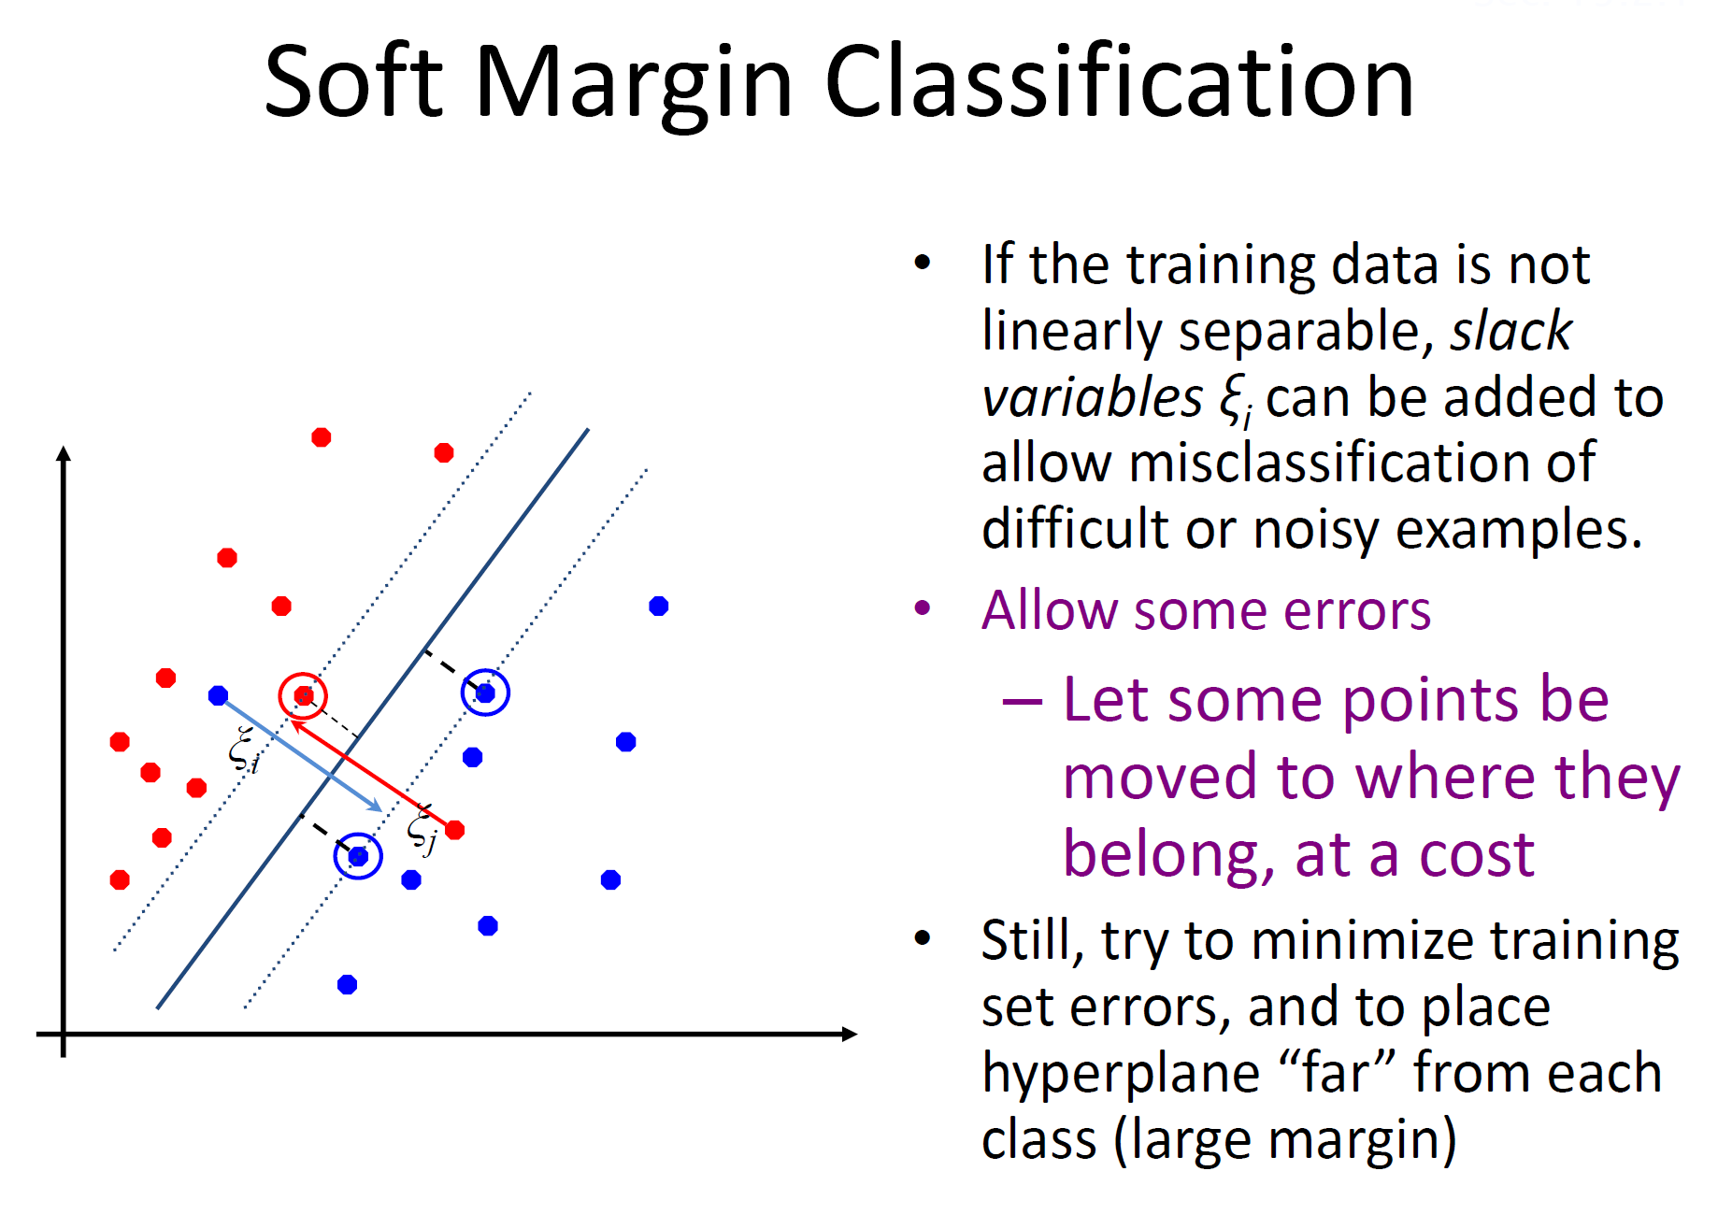

Slide 14
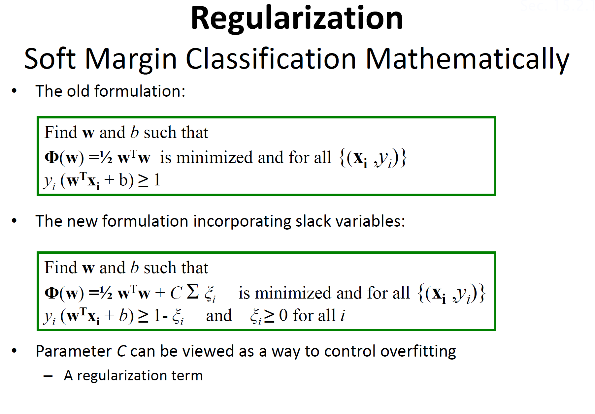

Slide 15
Lecture 10.0 Cloud Computing

Slide 16
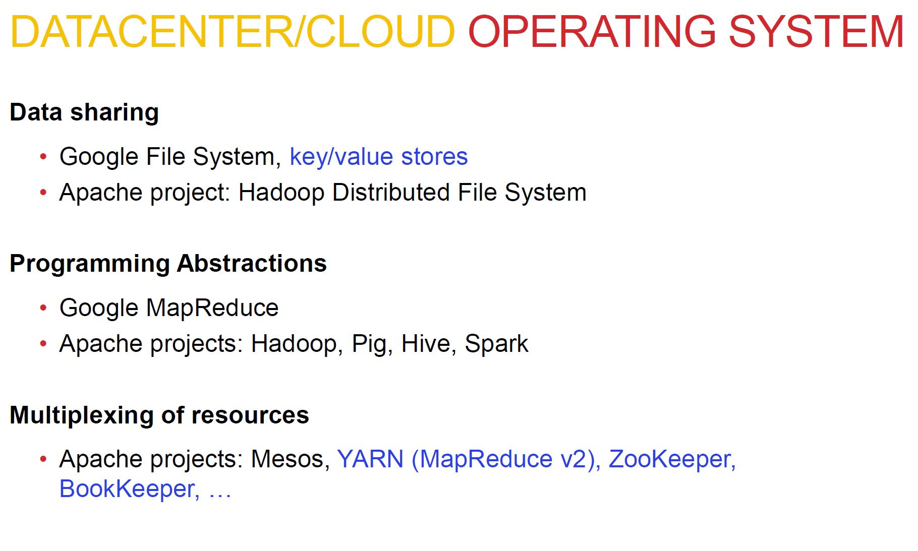

Slide 17
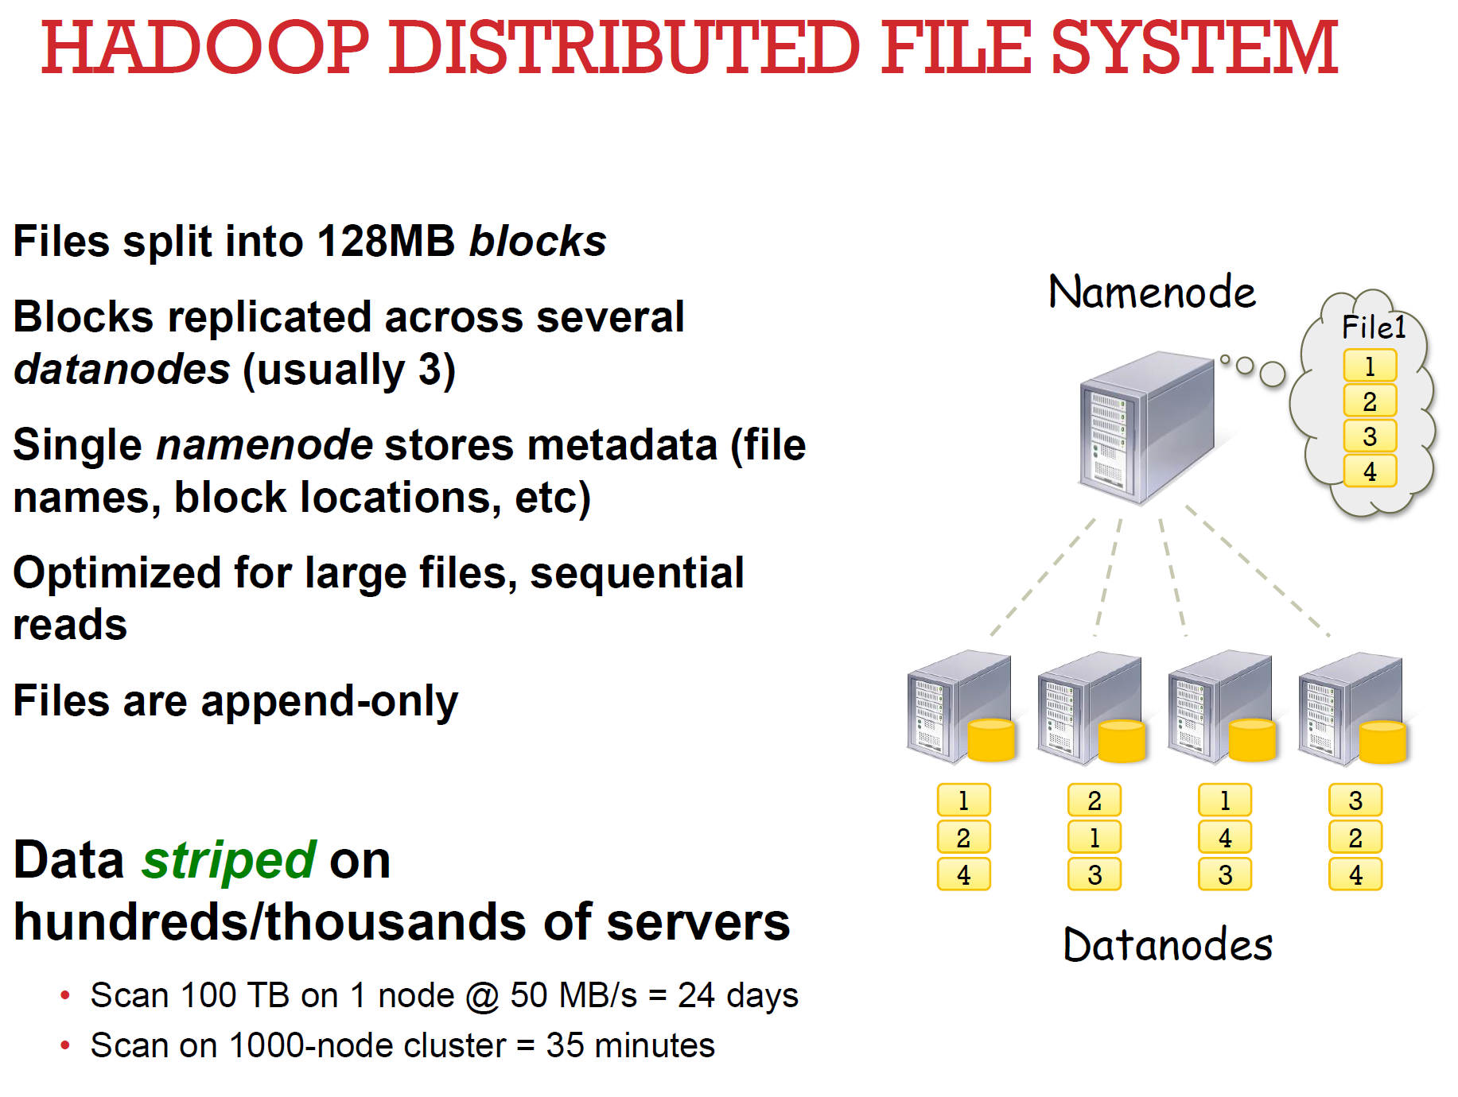

Slide 18
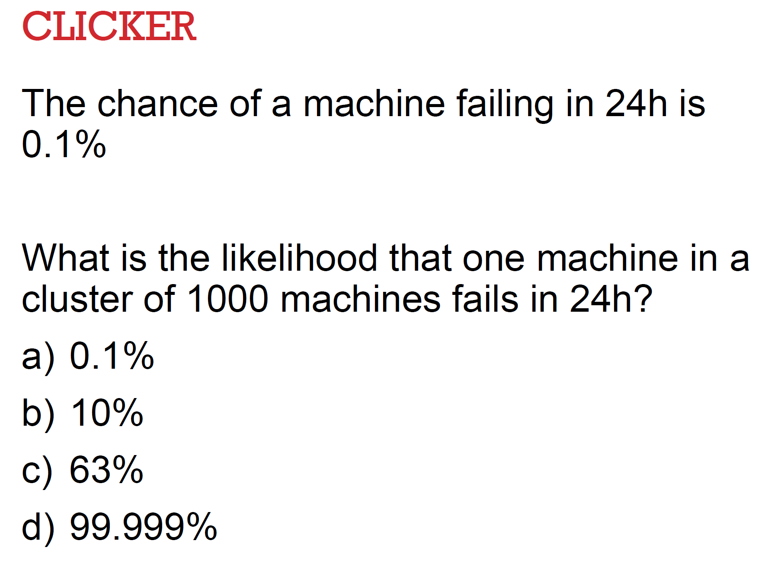
P(one fail) = 1- P(none fail) =
1 – (.999^1000) = 1 - .367 ~= .63
B

Slide 19
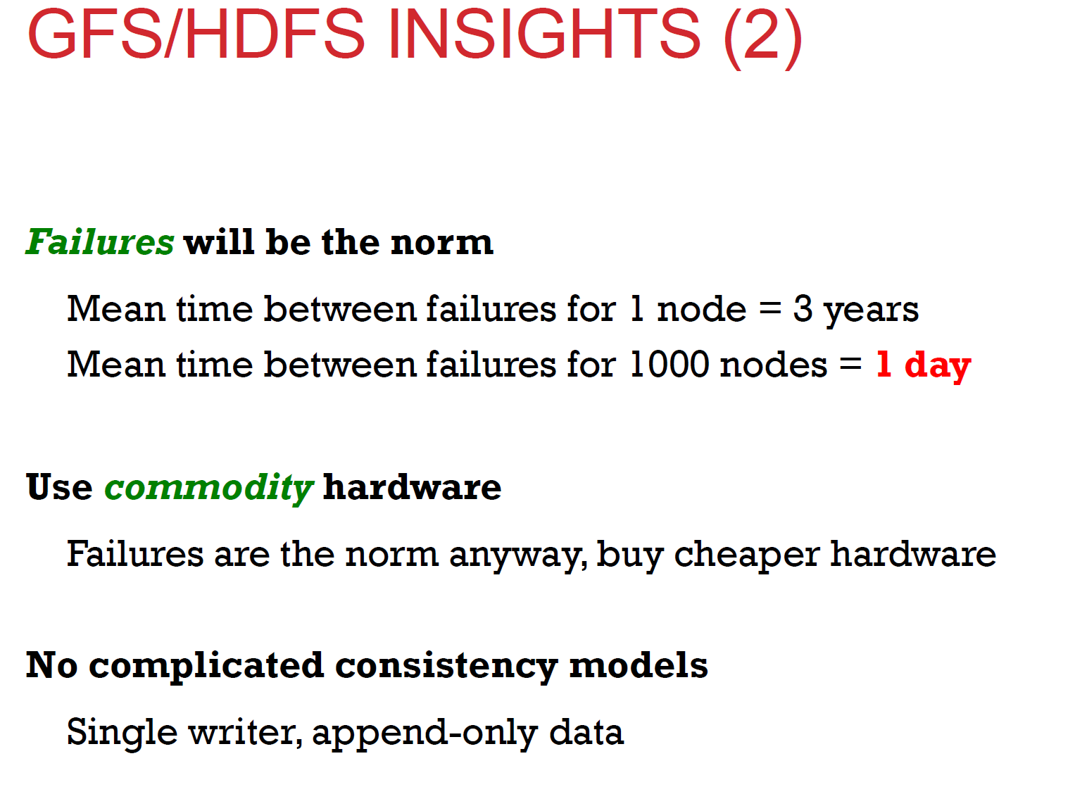

Slide 20
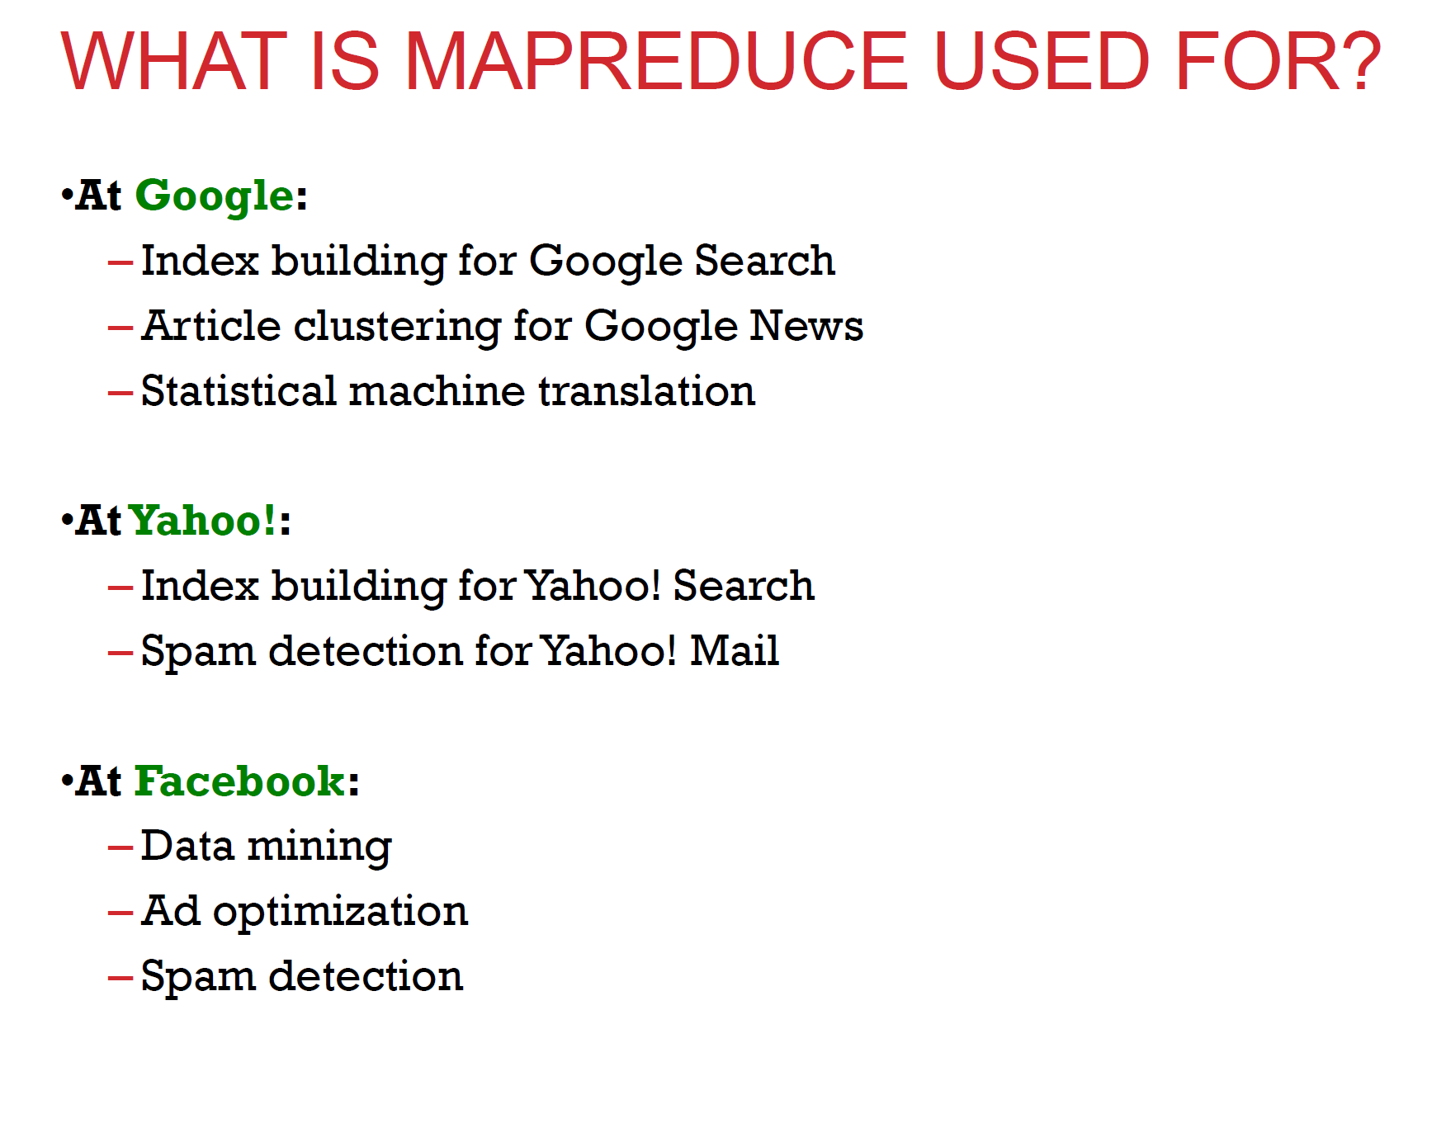

Slide 21
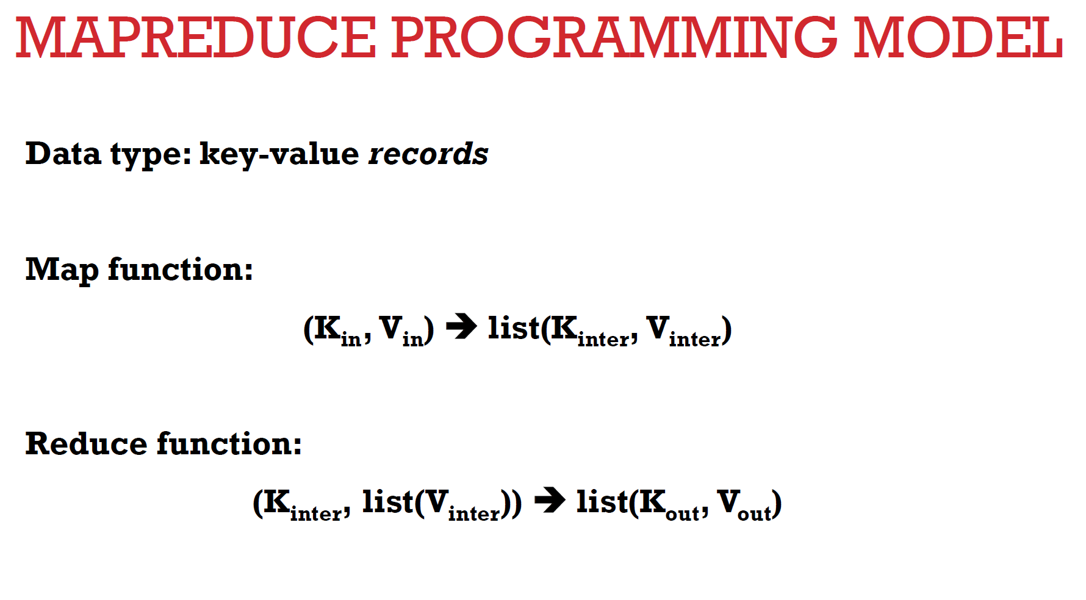
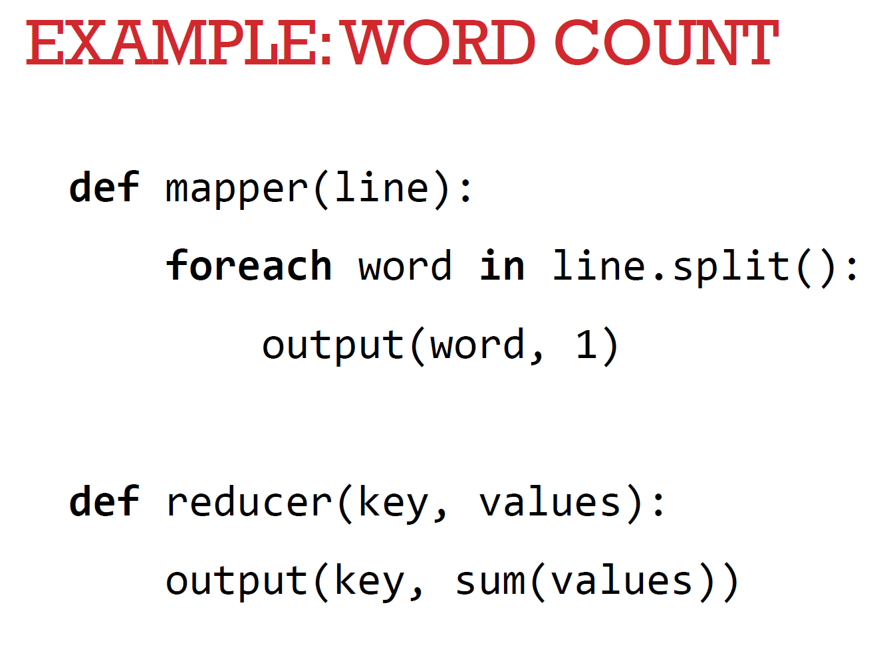

Slide 22
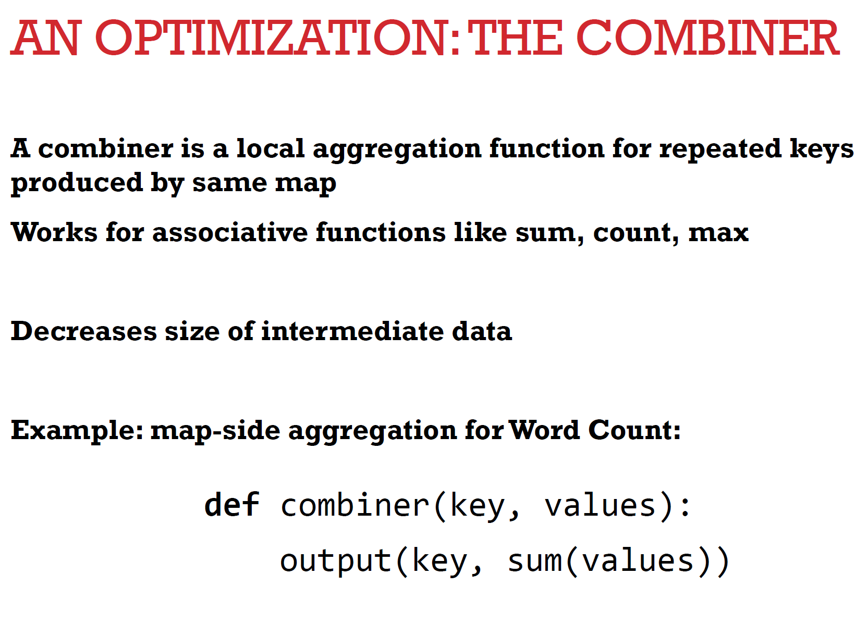

Slide 23
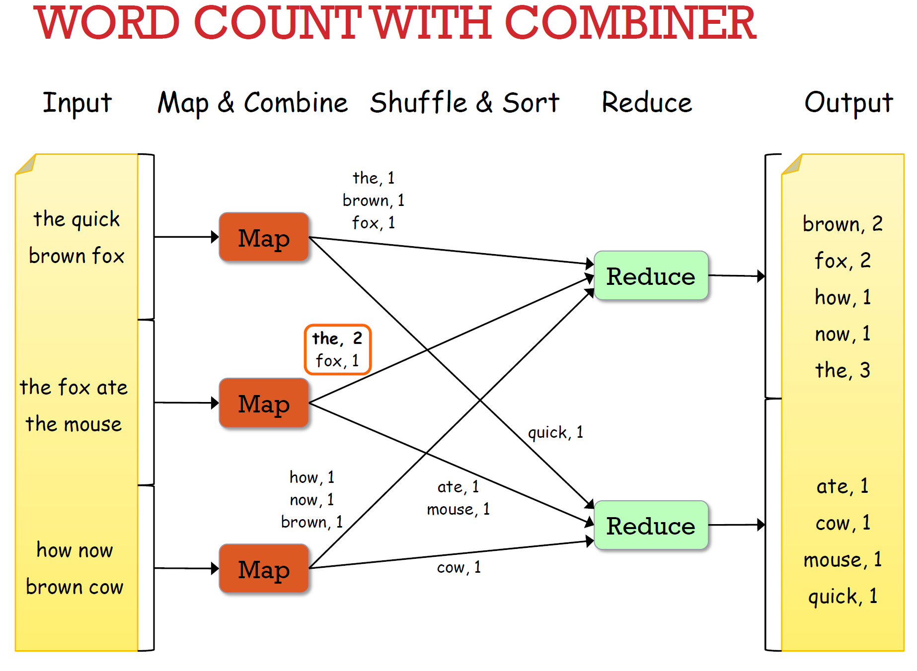

Slide 24
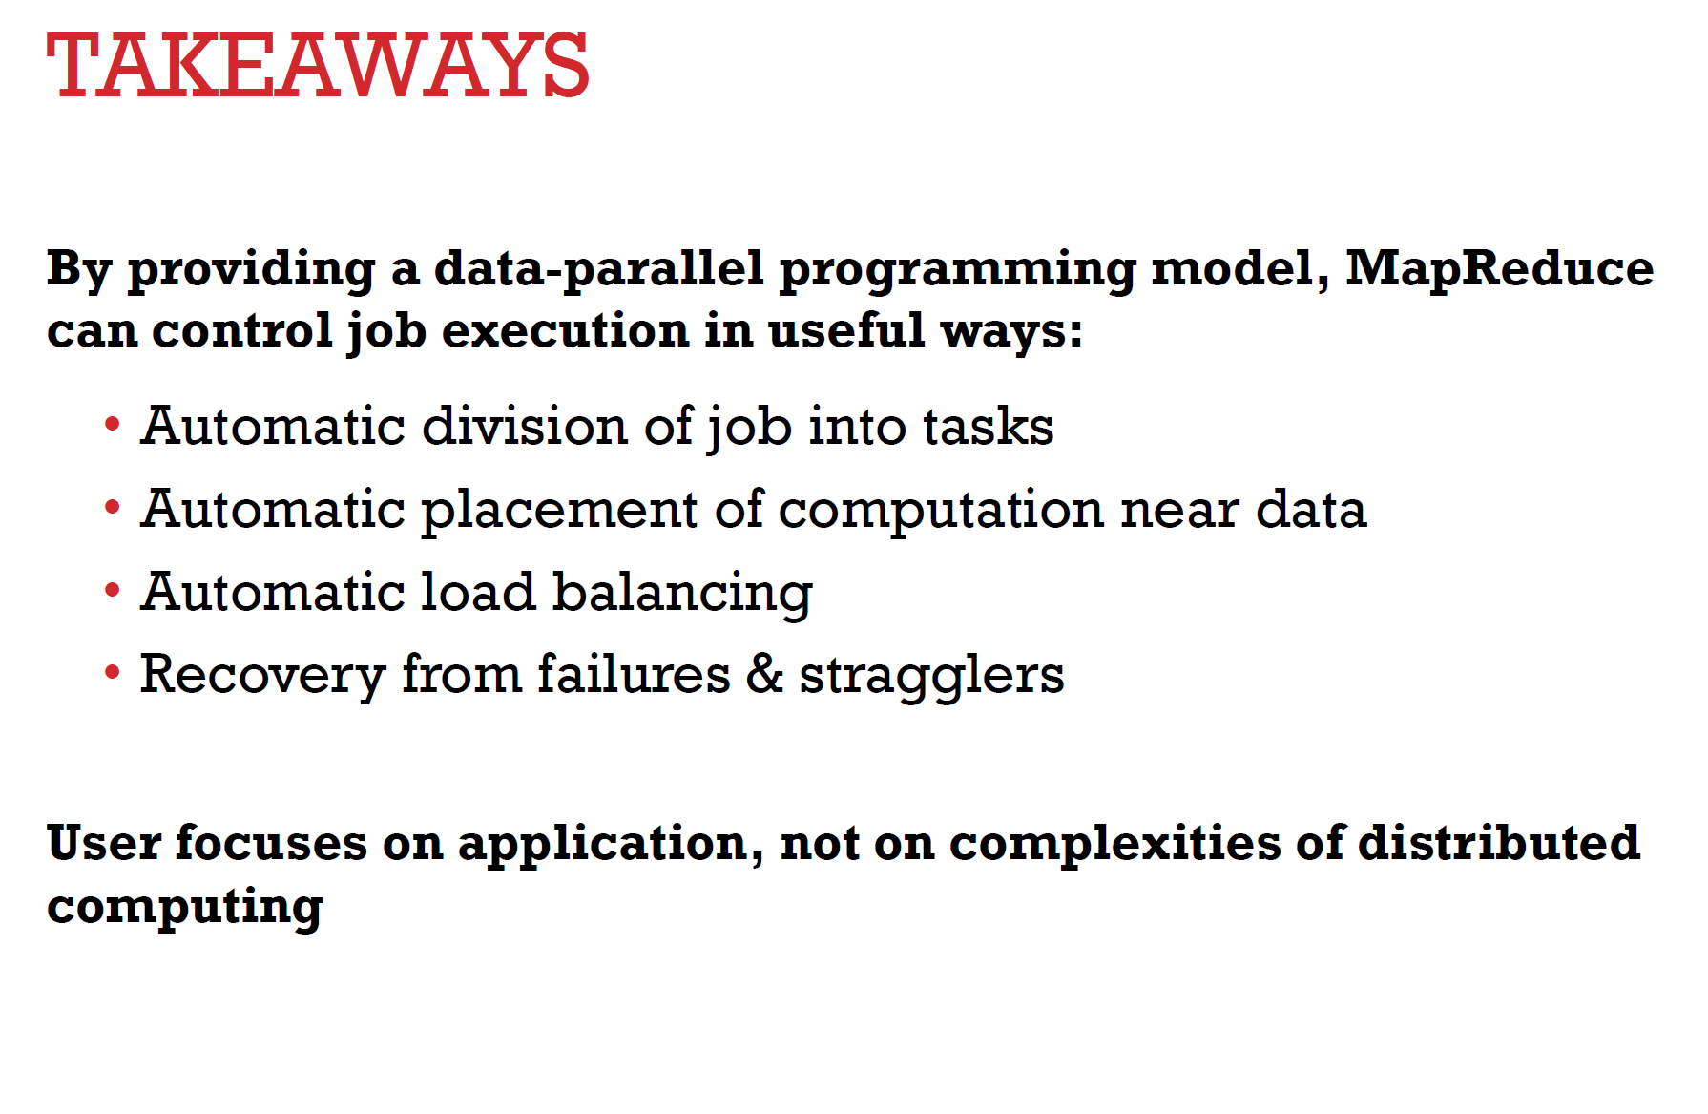

Slide 25
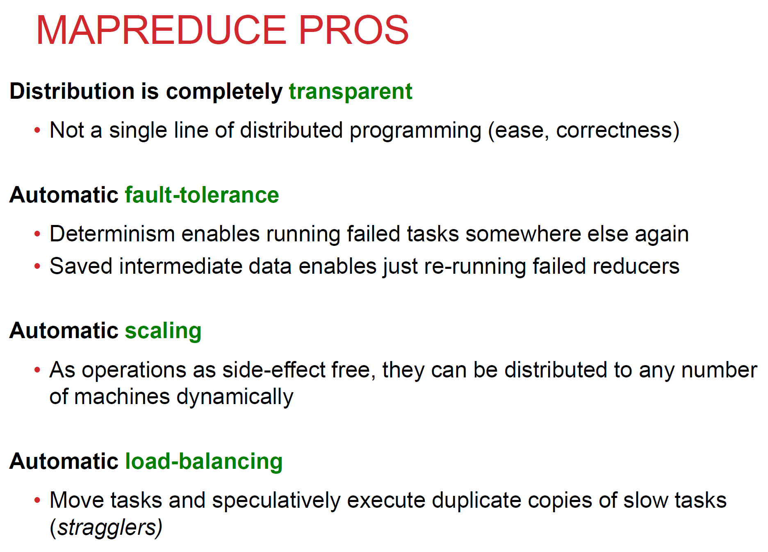

Slide 26
Lecture 10.5 Hadoop

Slide 27
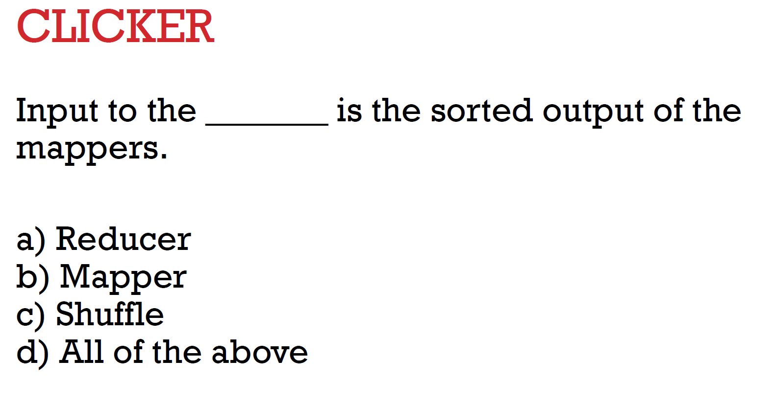
A: reducer (right?)

Slide 28
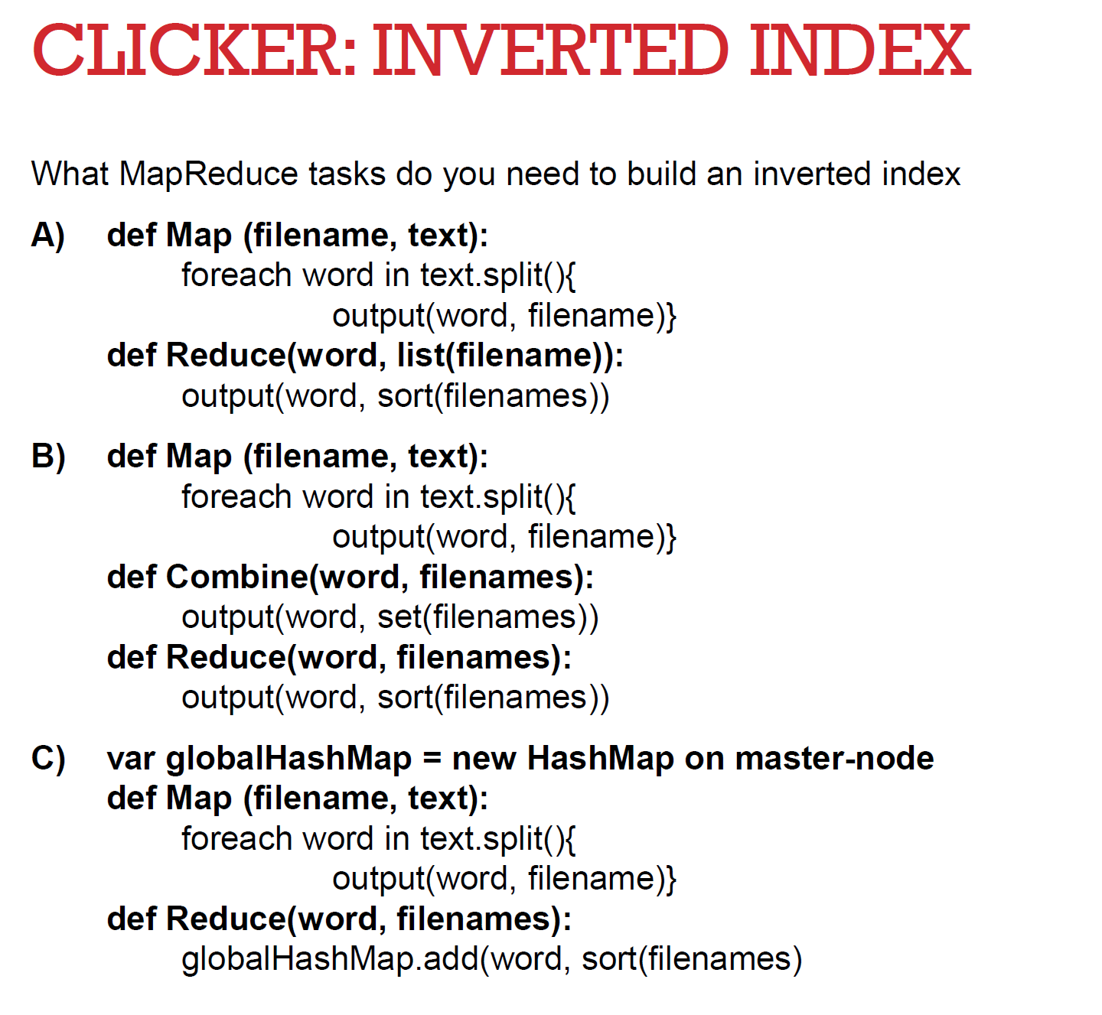
B

Slide 29
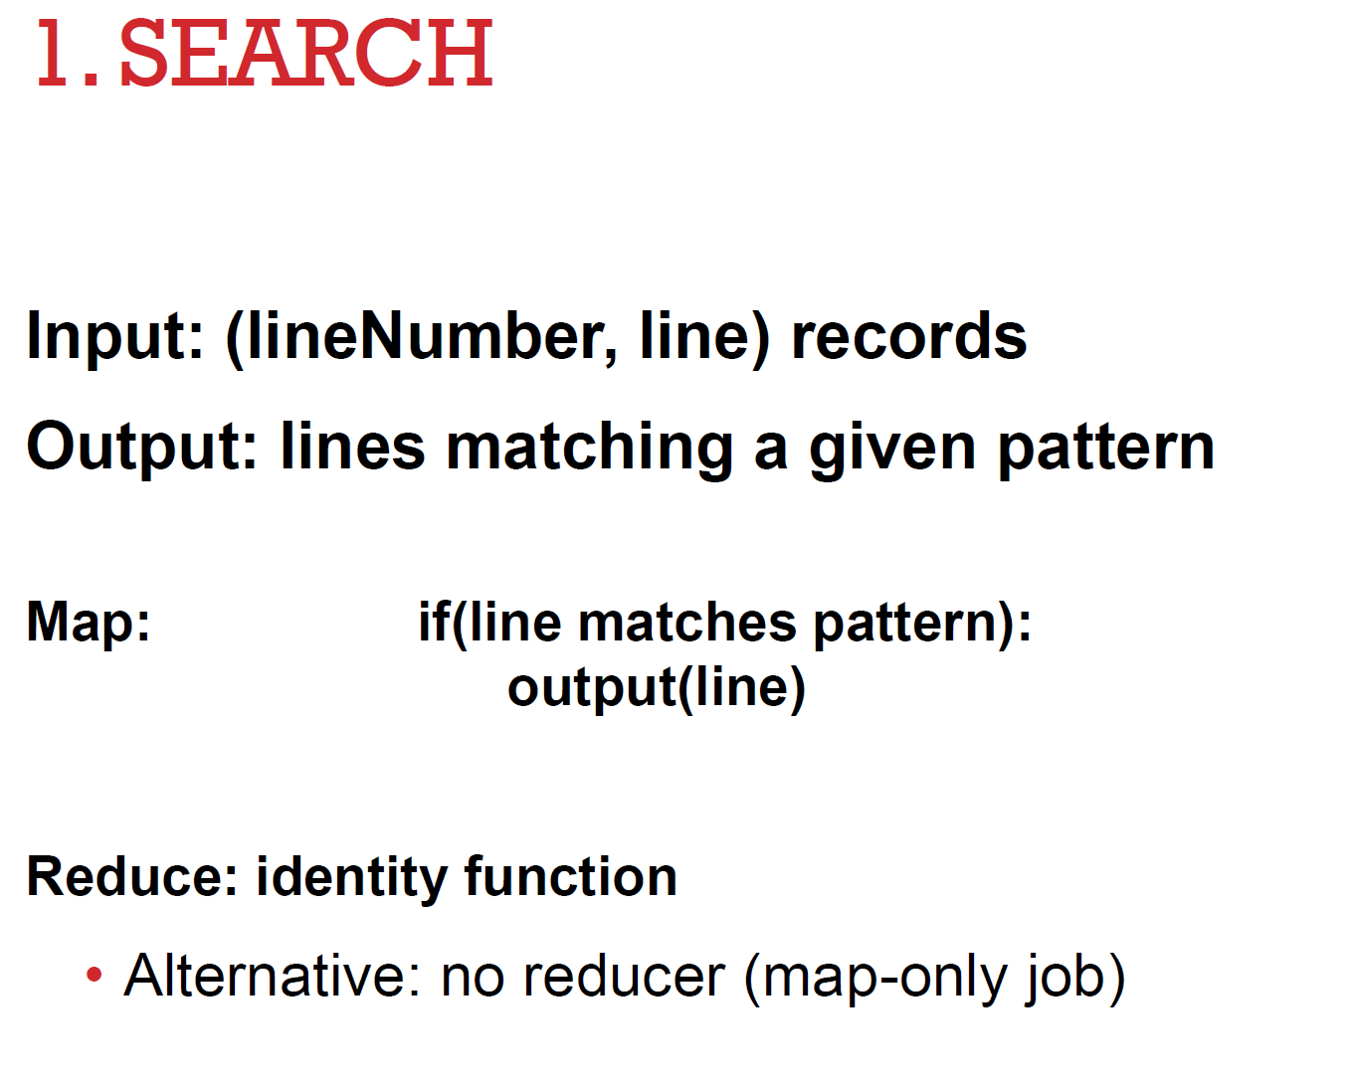

Slide 30
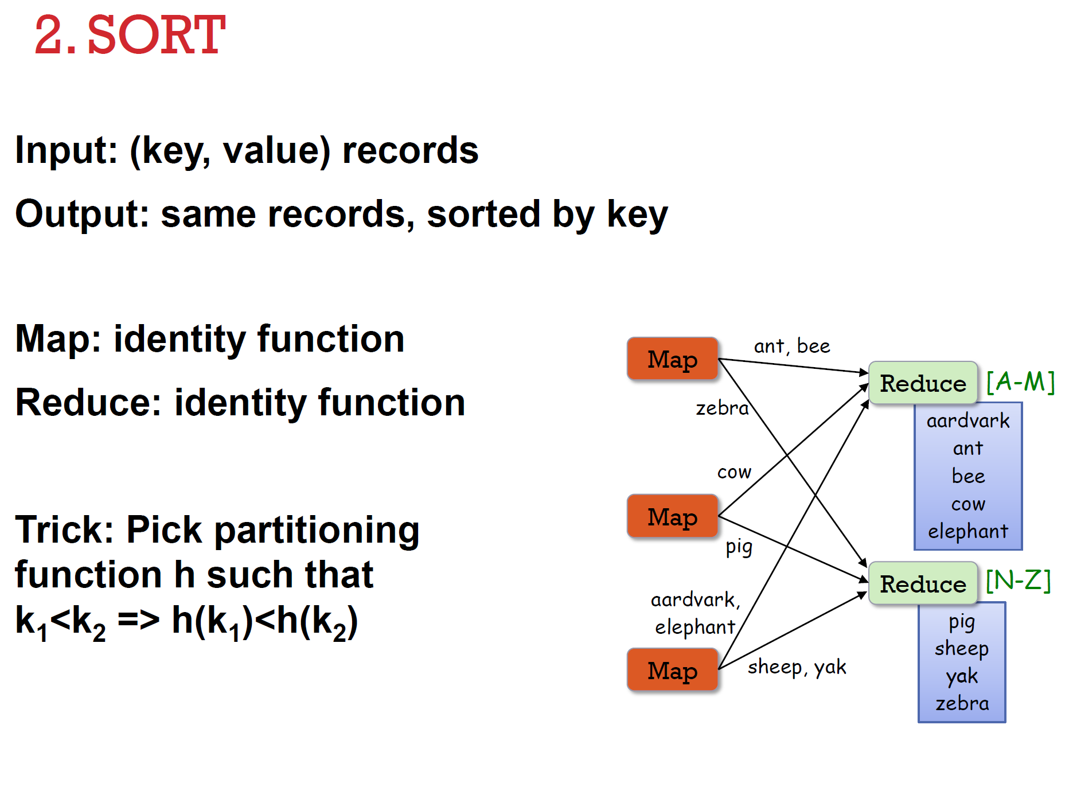

Slide 31
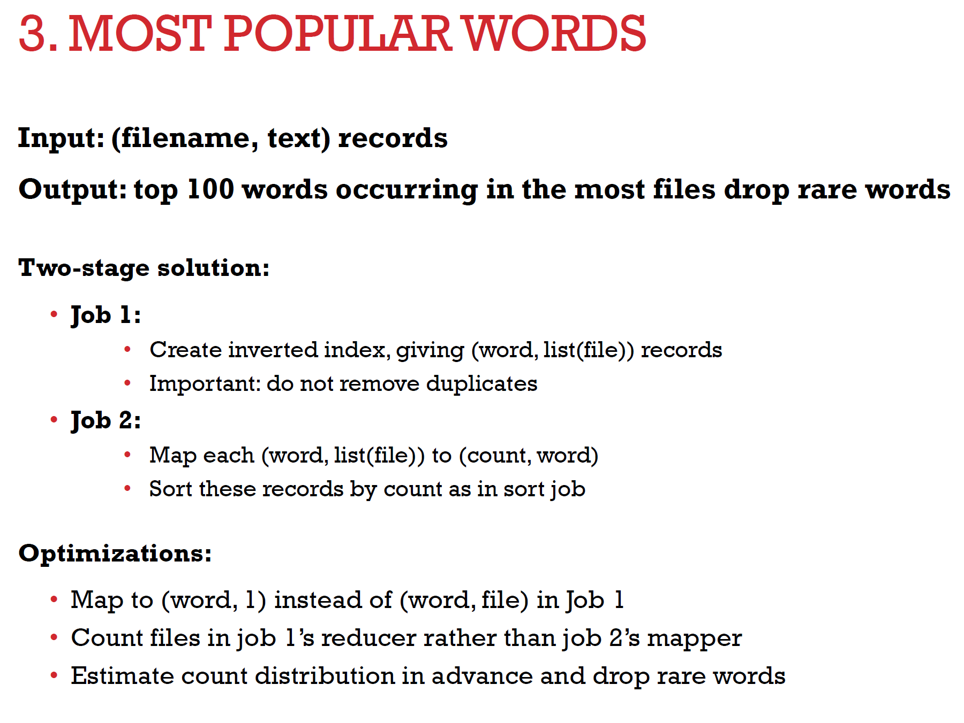

Slide 32
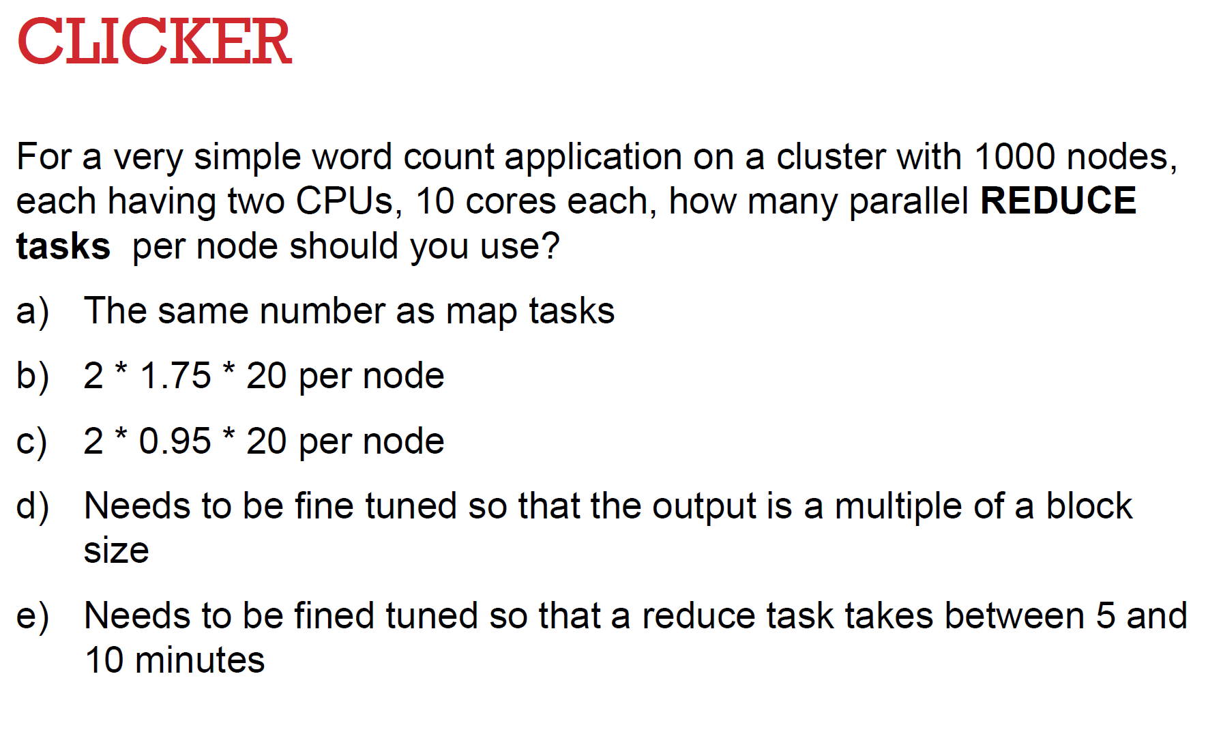
B or C

Slide 33
Lecture 11.0 Linear Regression

Slide 34
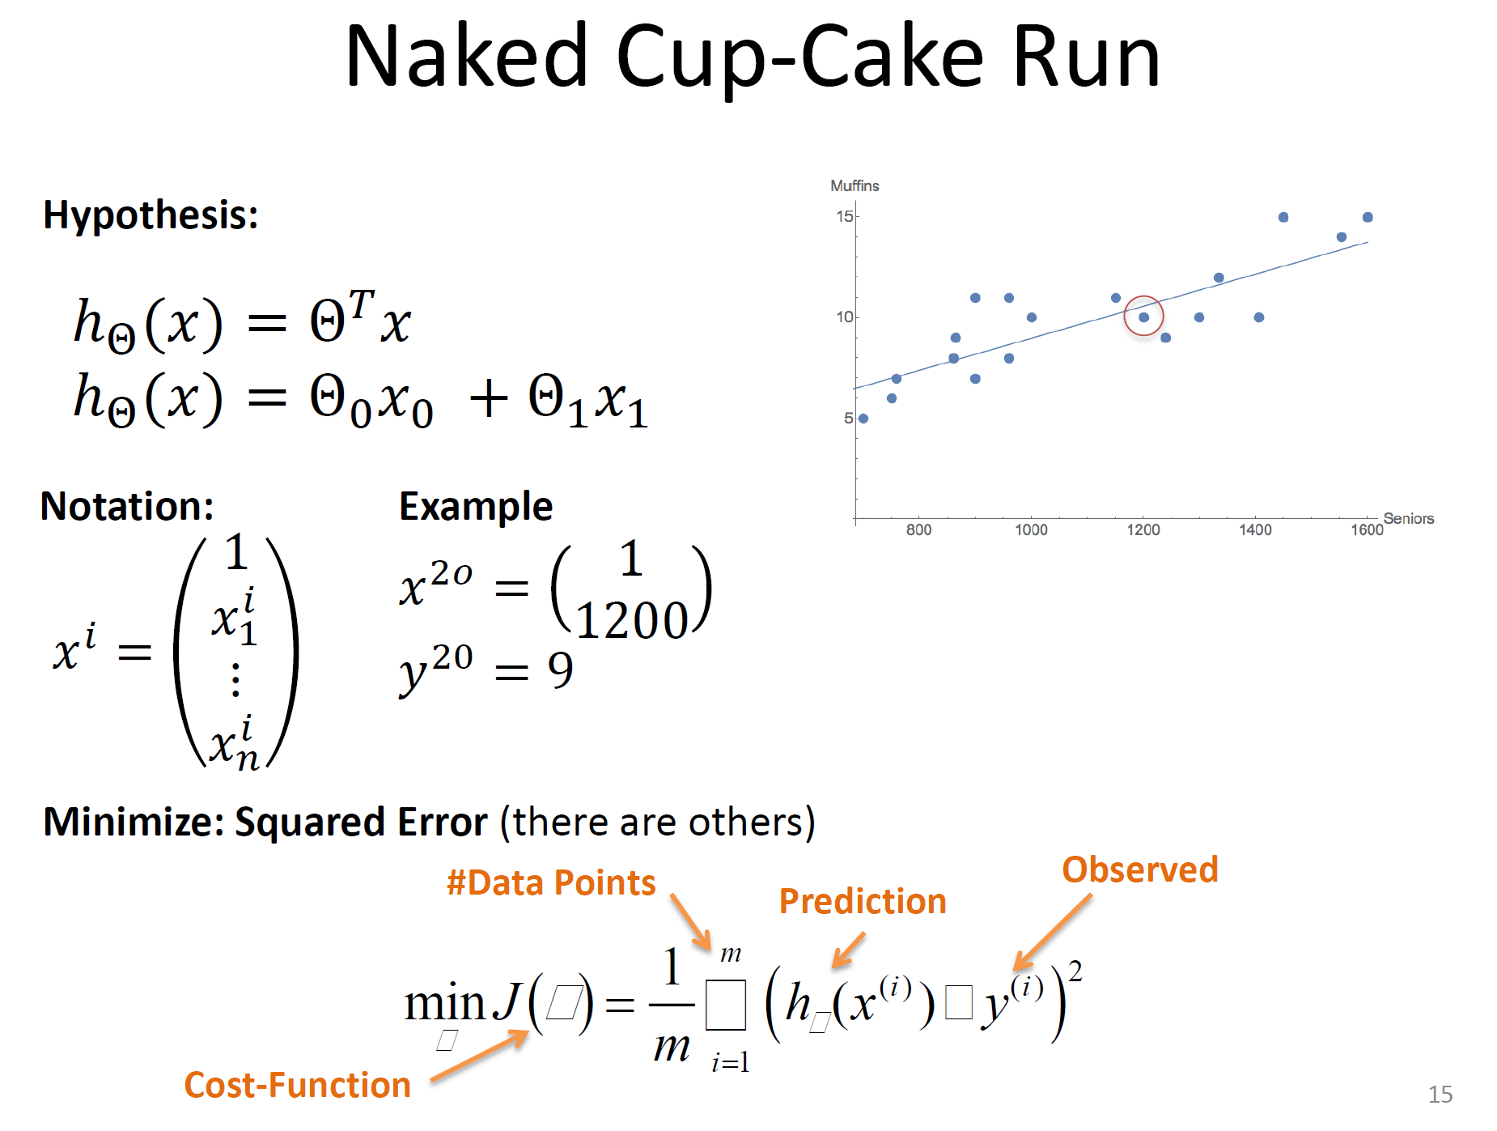

Slide 35
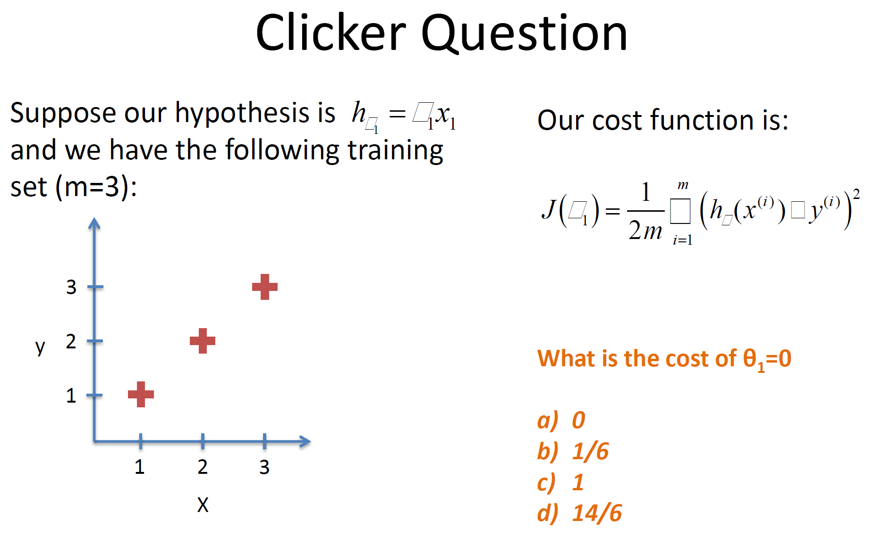
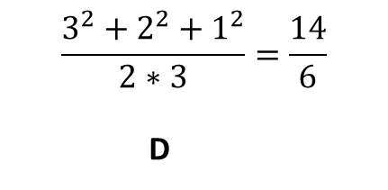
$$\frac{3^{2}+2^{2}+1^{2}}{2∗3}=\frac{14}{6}$$
D

Slide 36
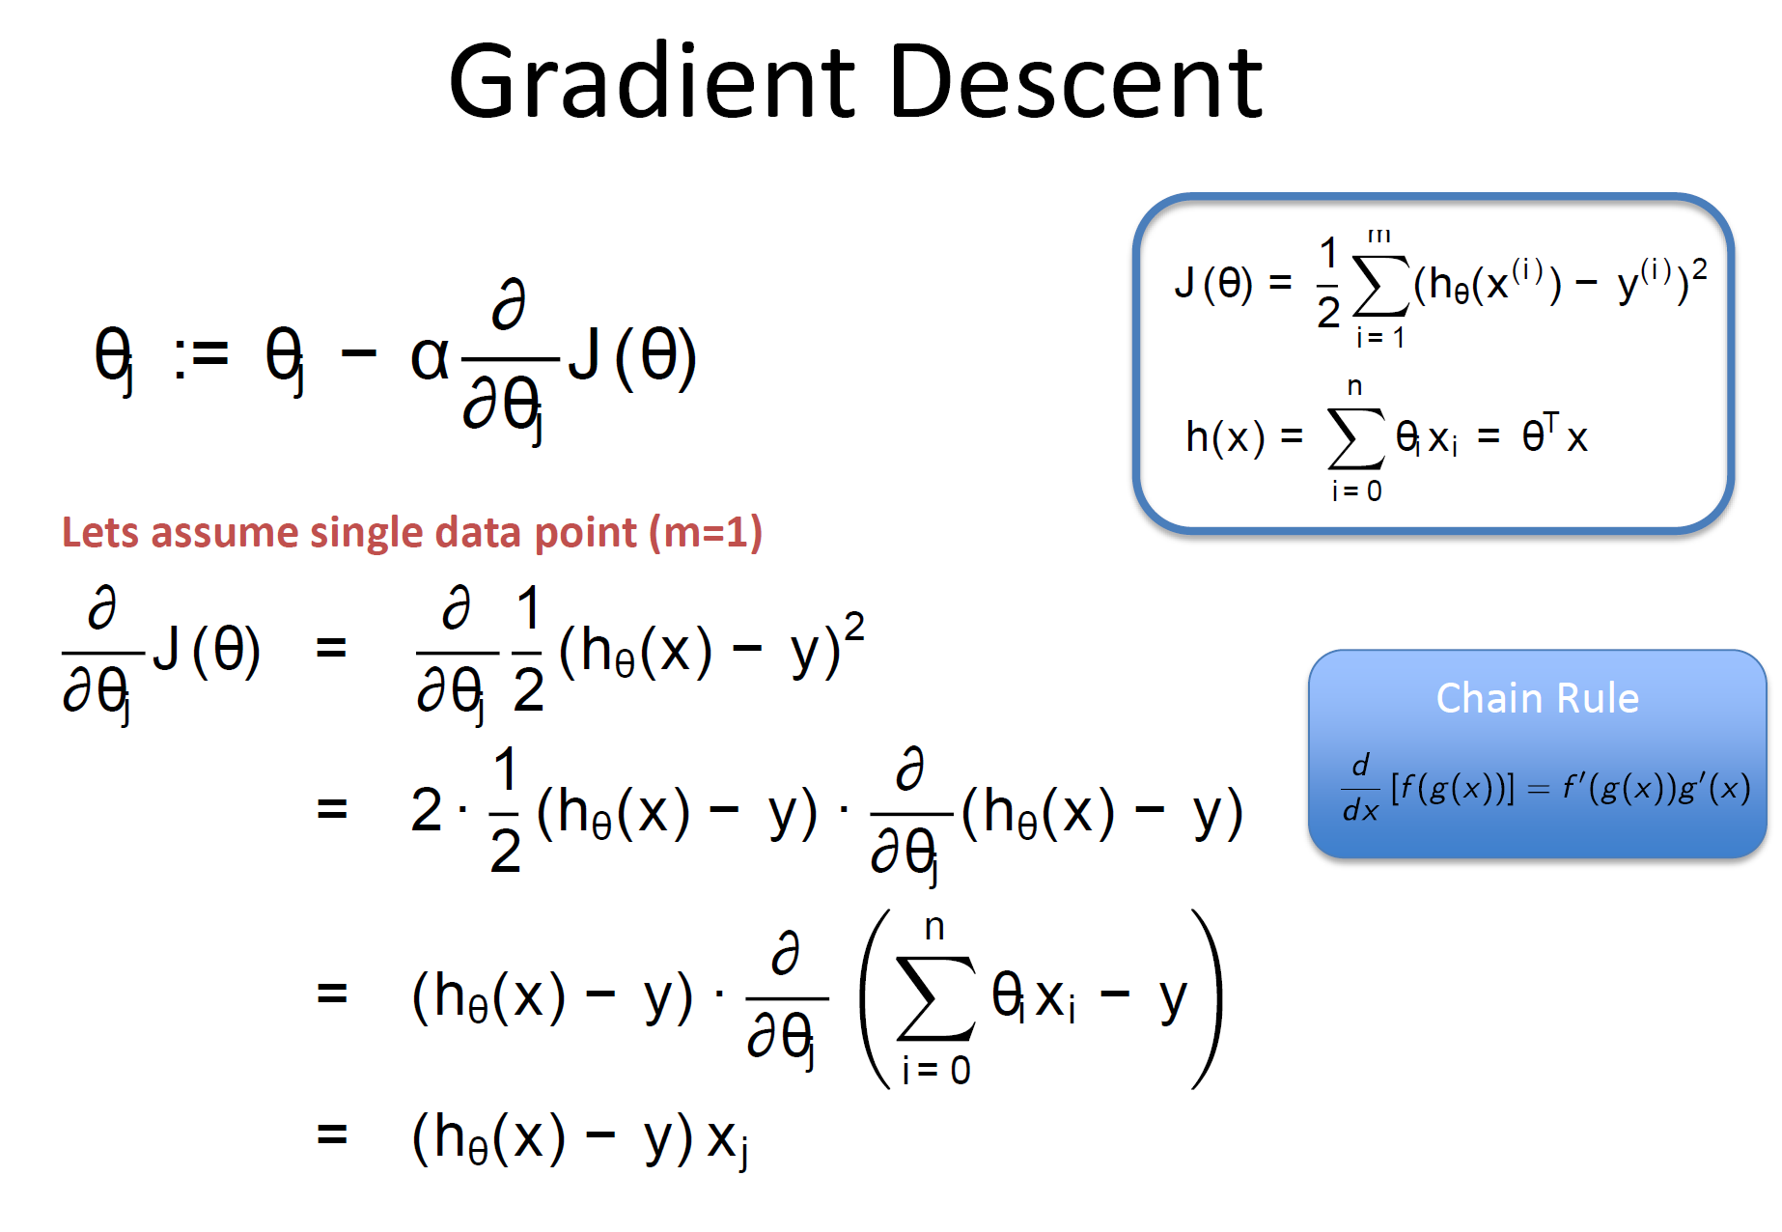

Slide 37
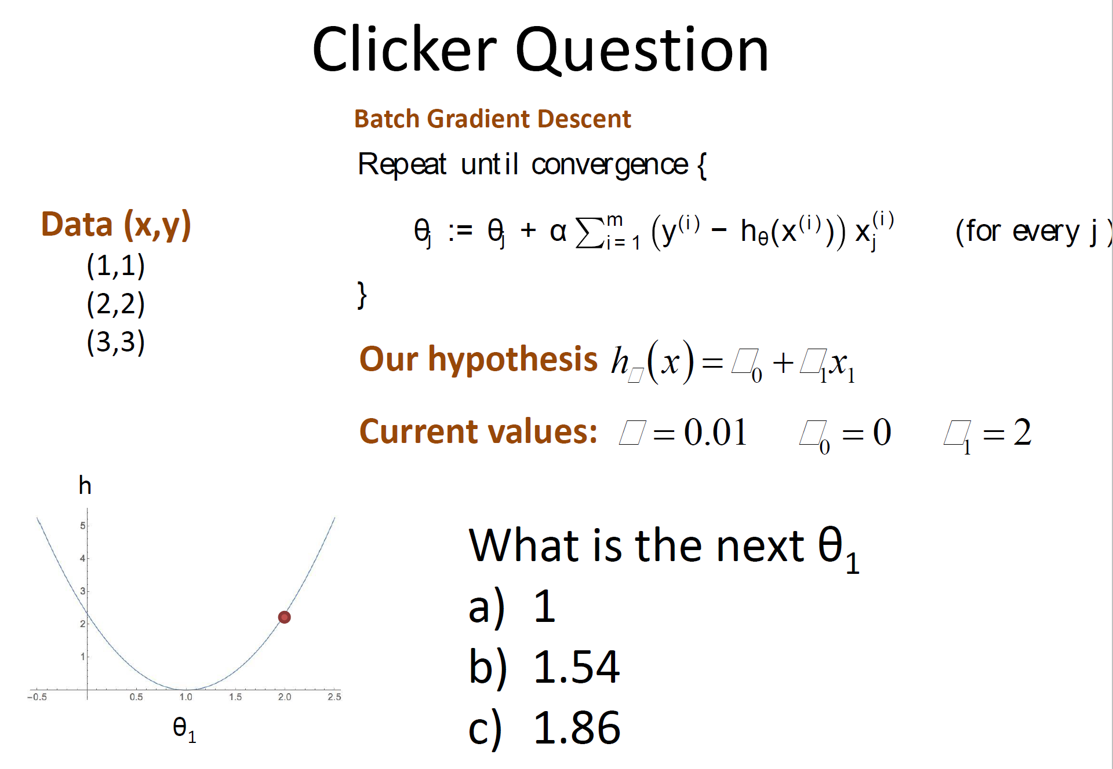
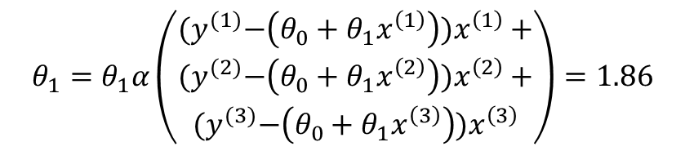
$$θ_{1}=θ_{1}α\left(\begin{matrix}{(y}^{(1)}−\left(θ_{0}+θ_{1}x^{\left(1\right)}\right))x^{\left(1\right)}+ \\ {(y}^{(2)}−\left(θ_{0}+θ_{1}x^{\left(2\right)}\right))x^{\left(2\right)}+ \\ {(y}^{(3)}−\left(θ_{0}+θ_{1}x^{\left(3\right)}\right))x^{\left(3\right)}\end{matrix}\right)=1.86$$

Slide 38
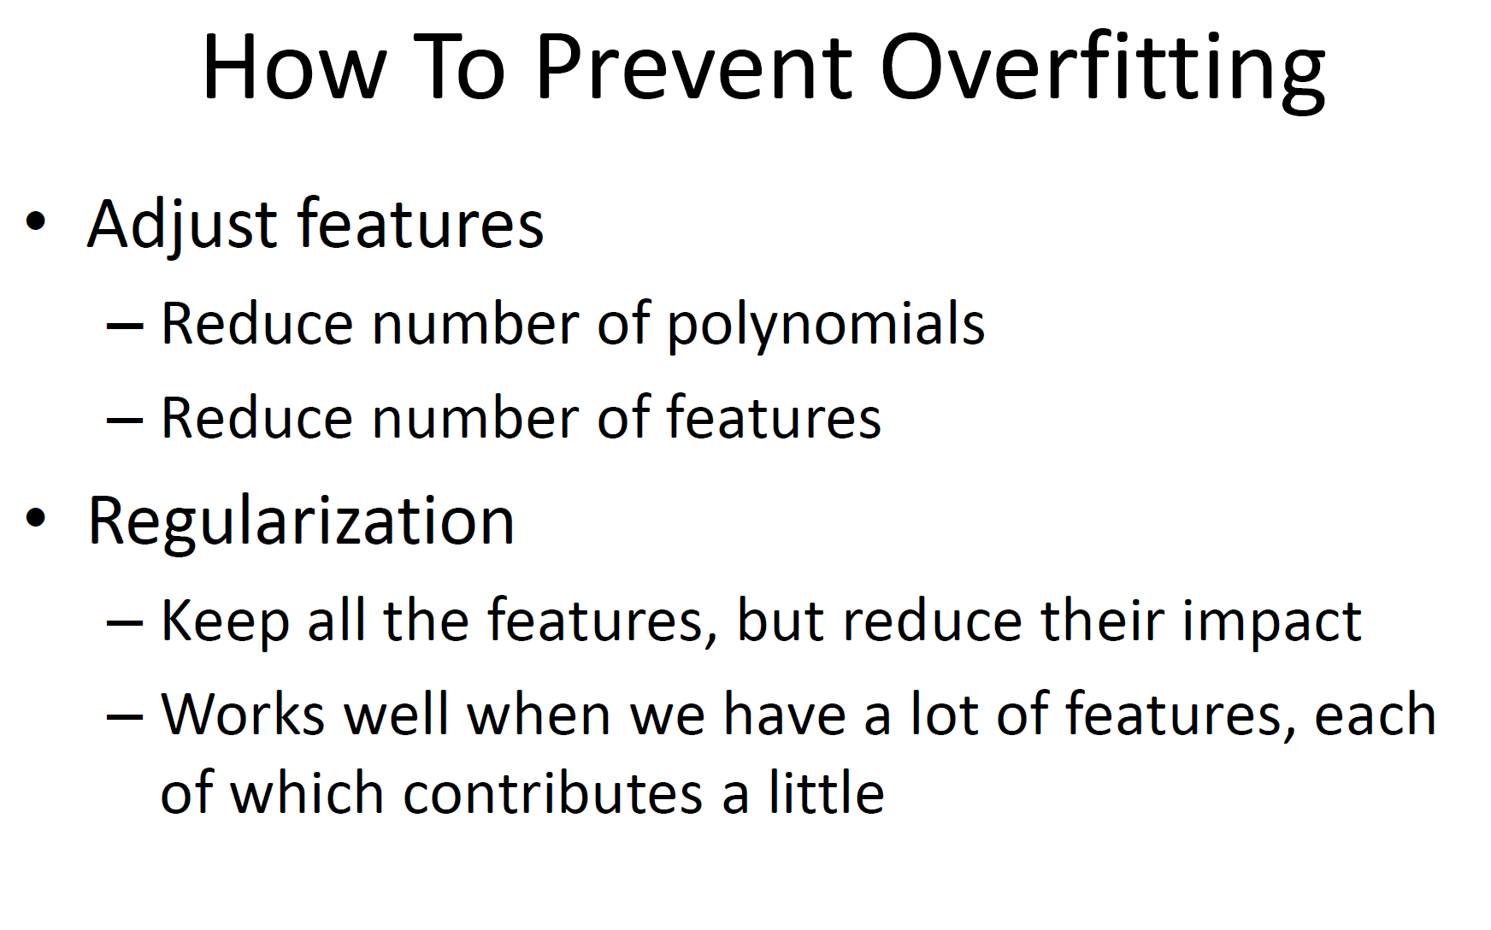

Slide 39
Lecture 11.5 Logistic Regression

Slide 40
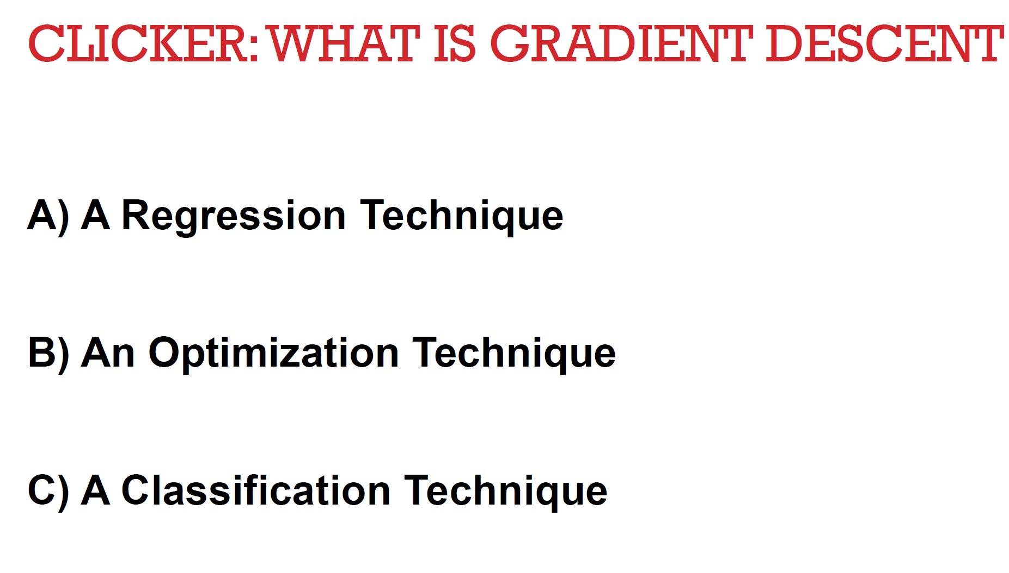
B

Slide 41
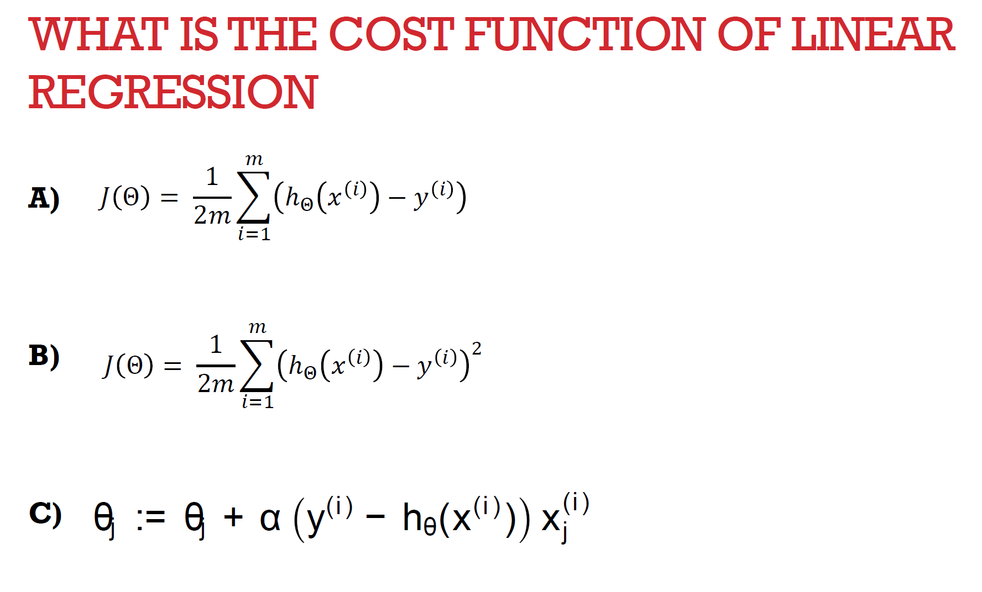
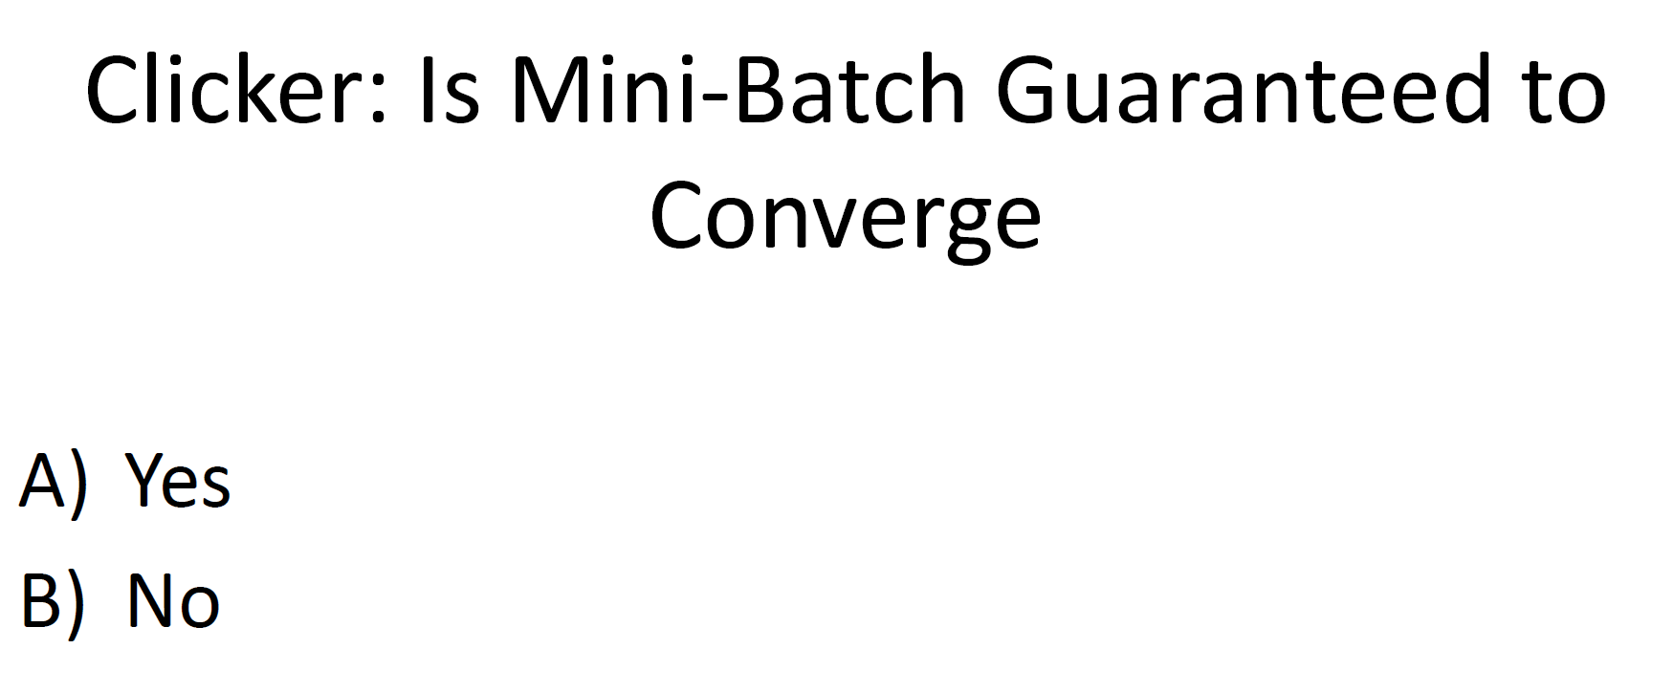
B
No

Slide 42
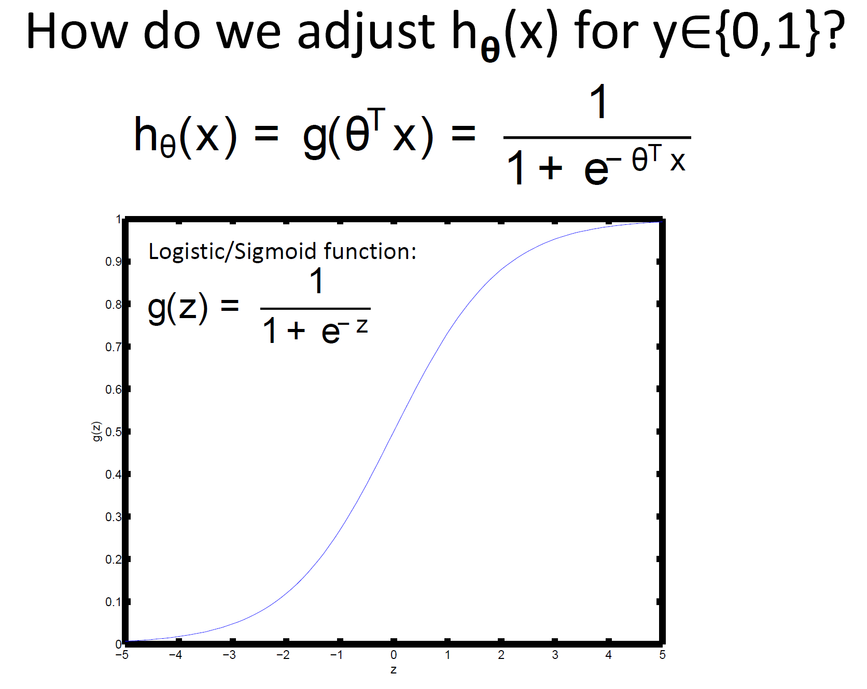

Slide 43
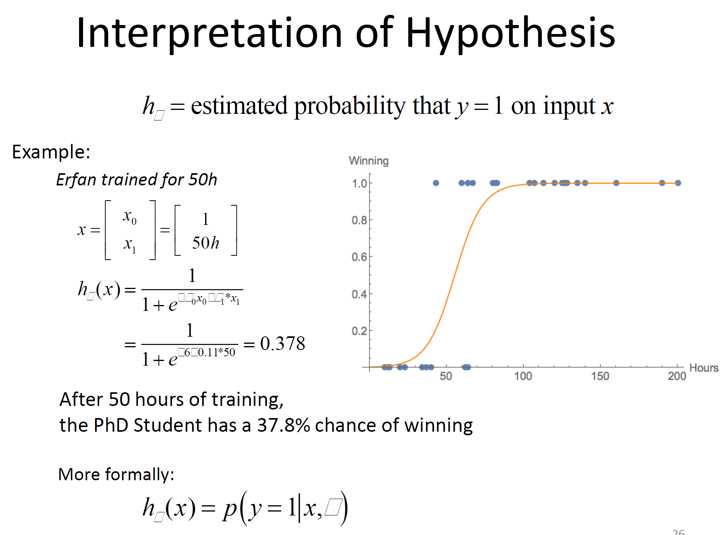

Slide 44
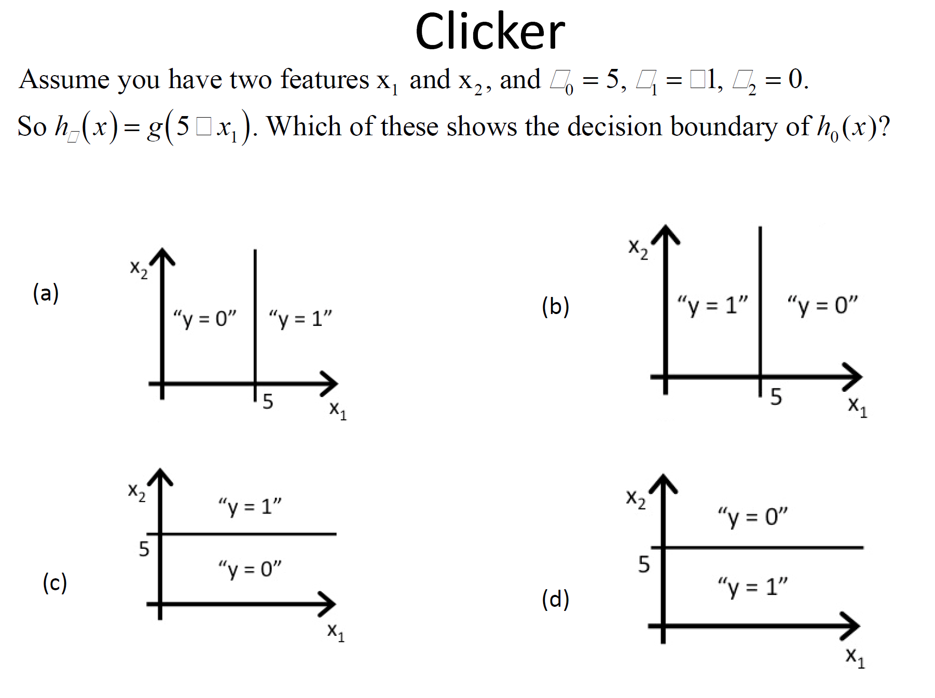
B

Slide 45
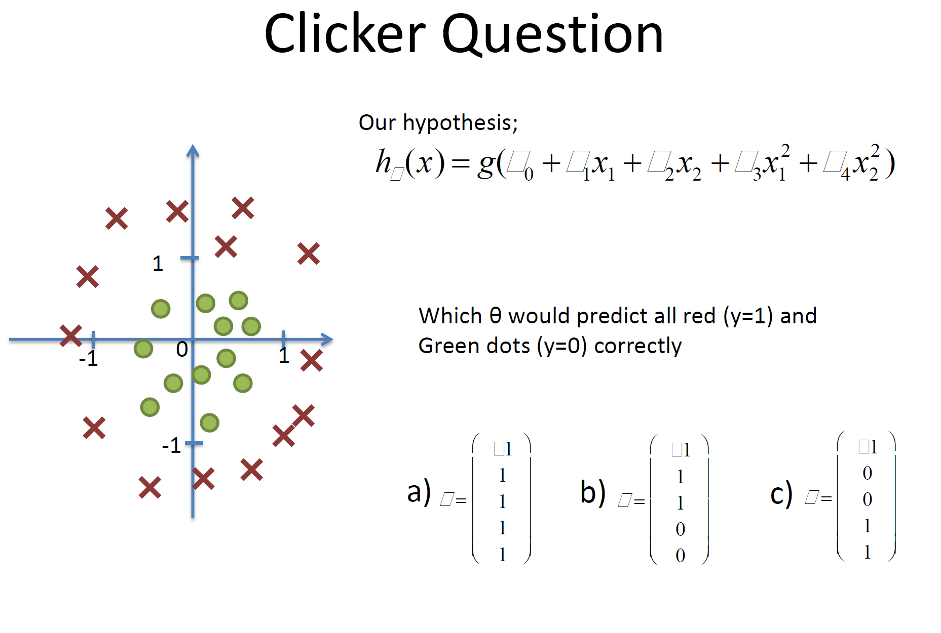
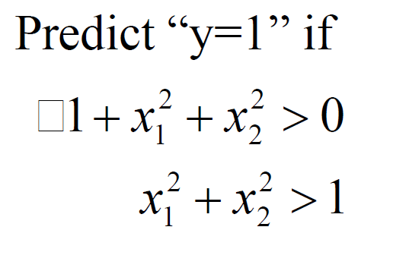
C
(boxes are negative sign)

Slide 46
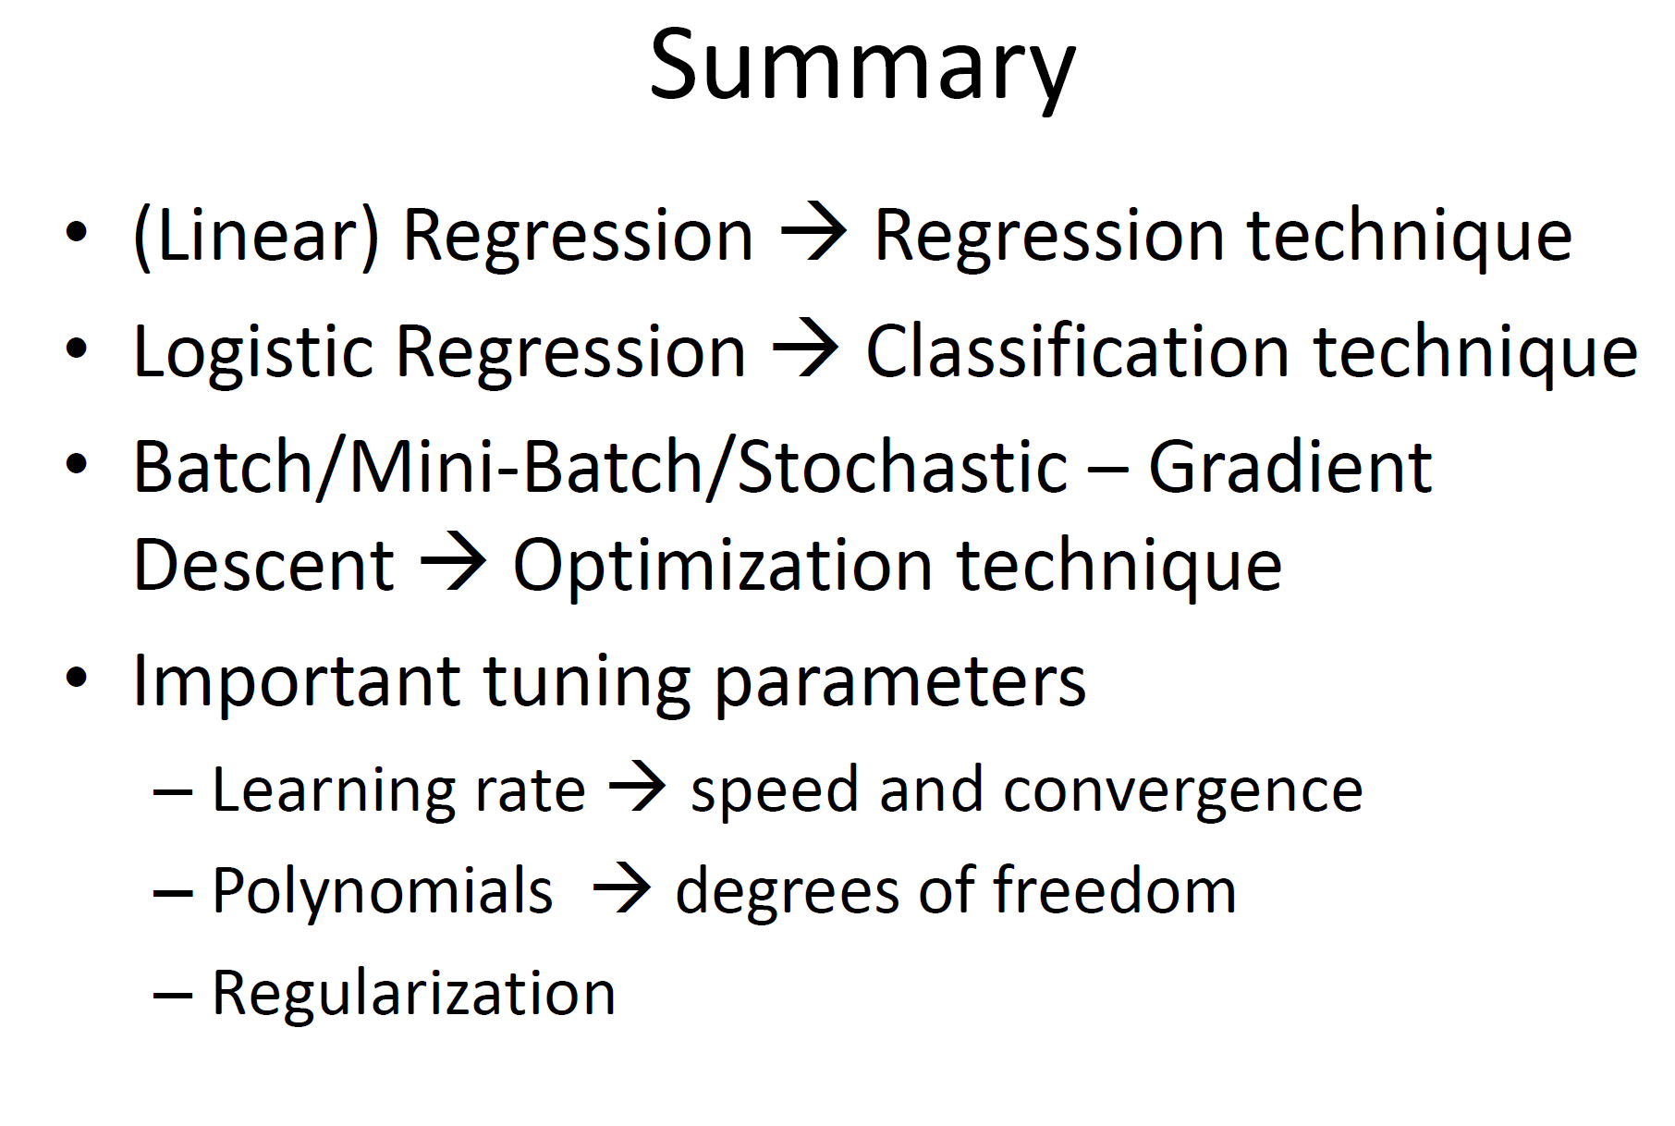

Slide 47
Lecture 12.0 Decision Trees

Slide 48
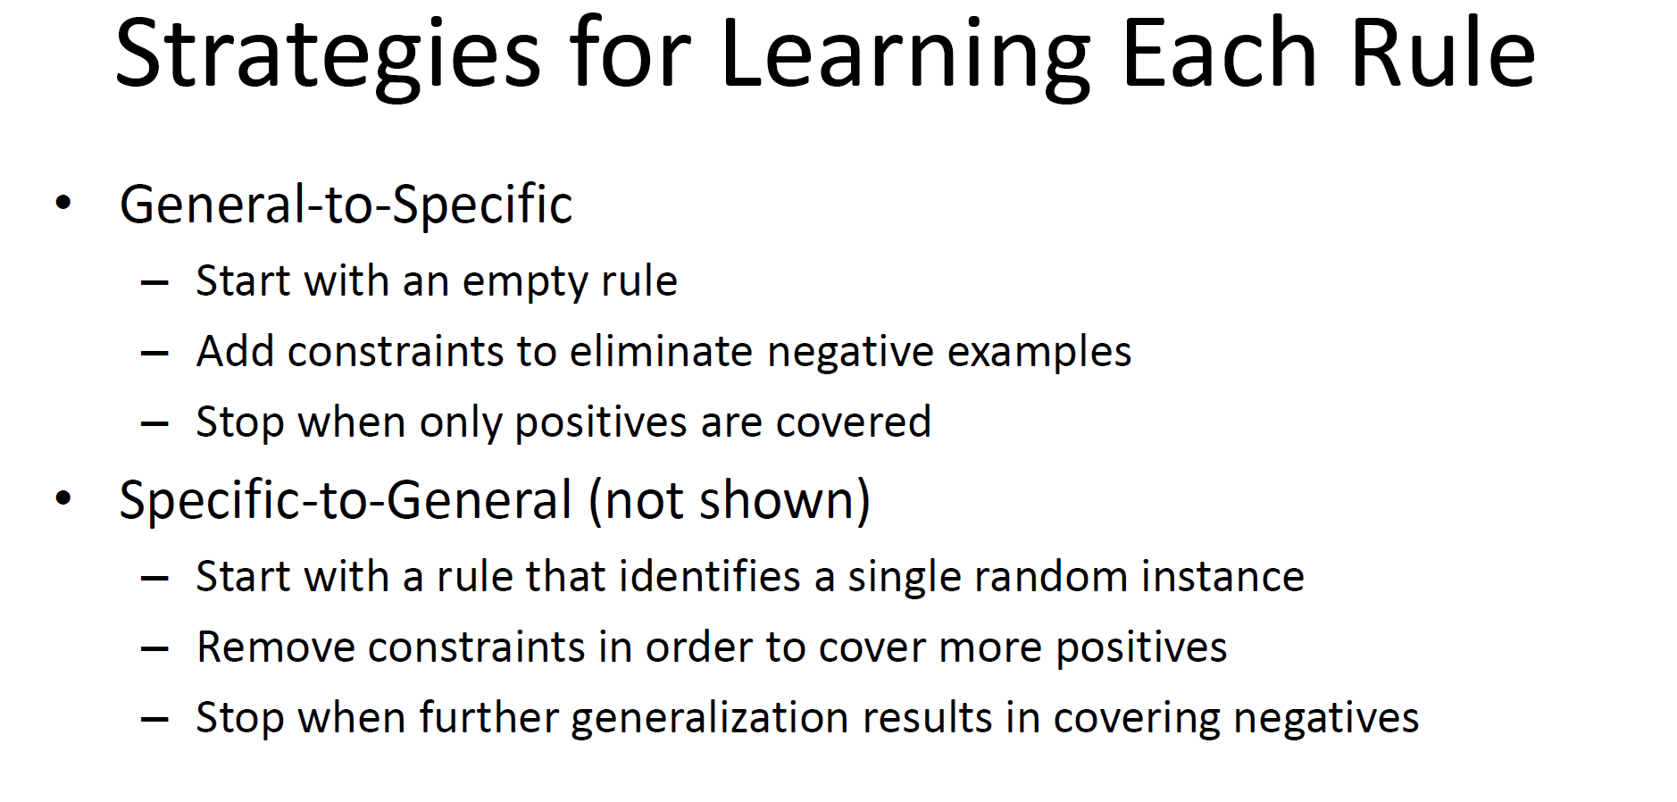

Slide 49
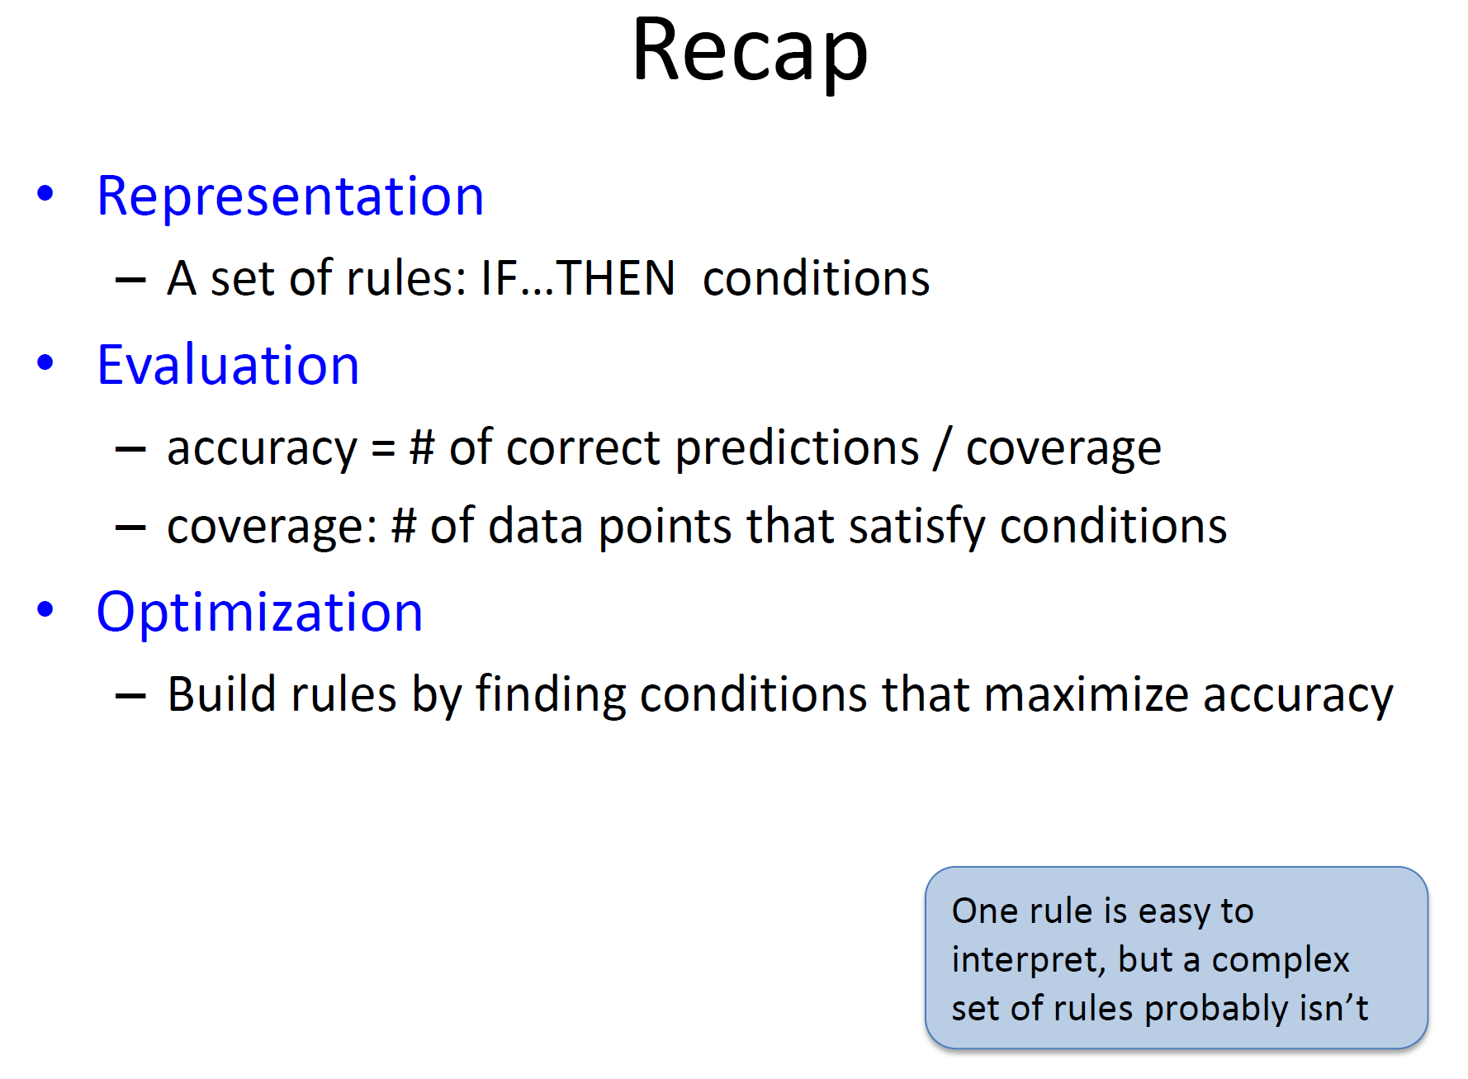

Slide 50
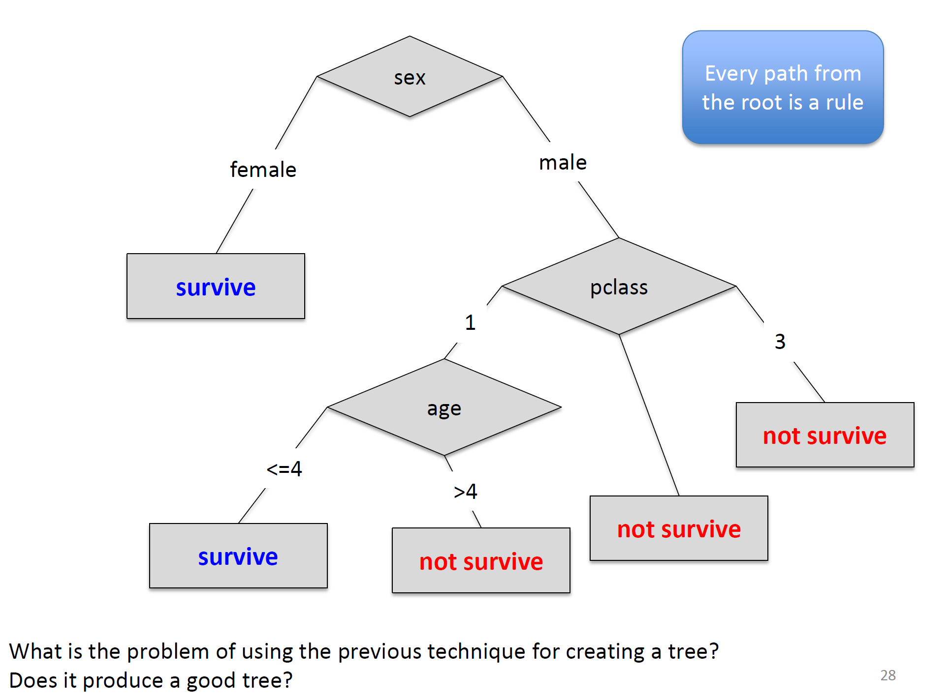

Slide 51
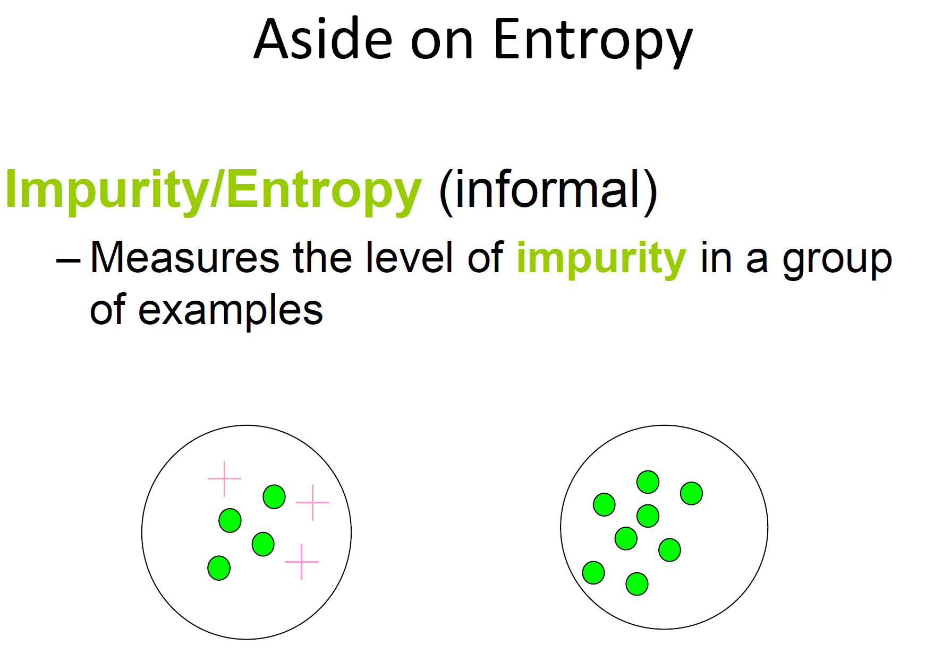

Slide 52
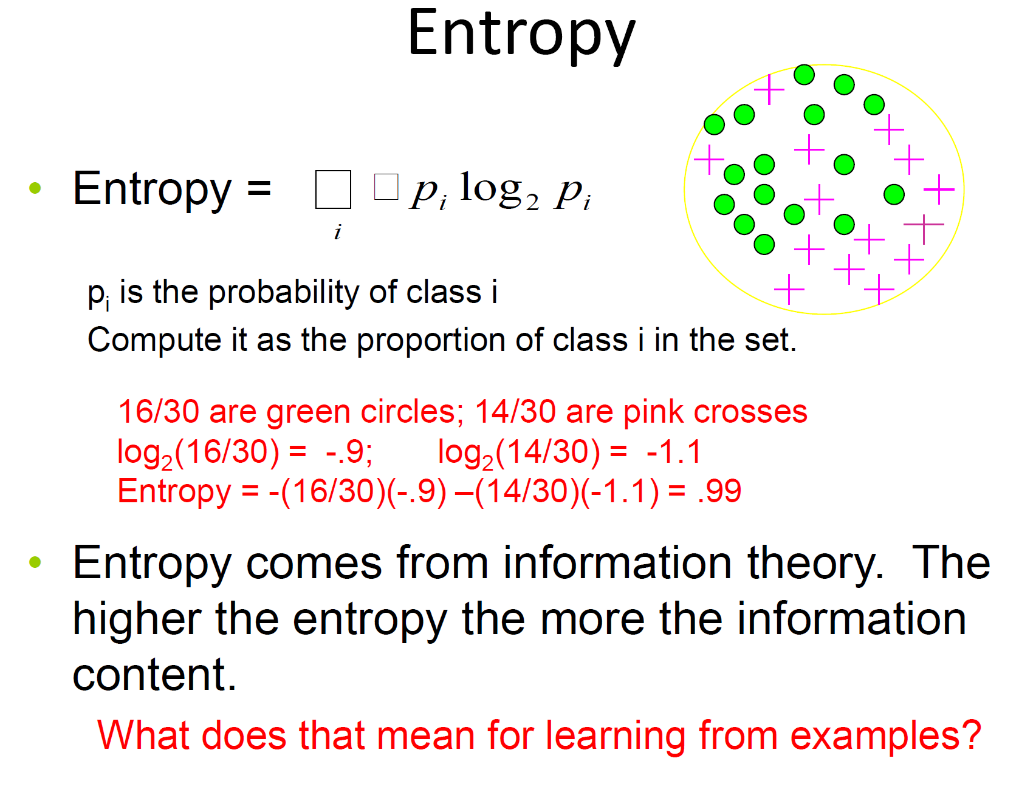

Slide 53
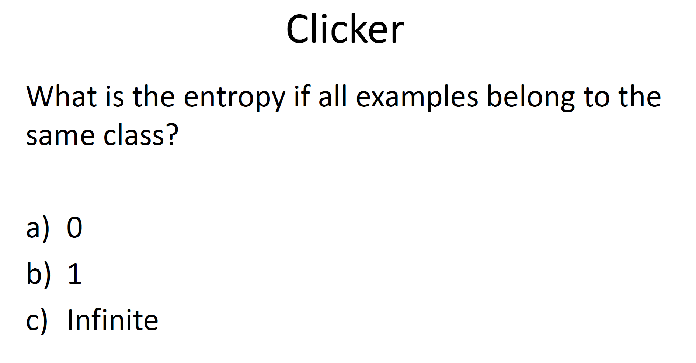

A
$$−ln\left(\frac{30}{30}\right)=−ln\left(1\right)=0$$

Slide 54


Slide 55


Slide 56


